Slide 1
DESIGN PROJECT
SECOND EVALUATION

Slide 2
JONATHAN REGGIE EBENEZER
S5 ME
ROLL NO: 38

Slide 3
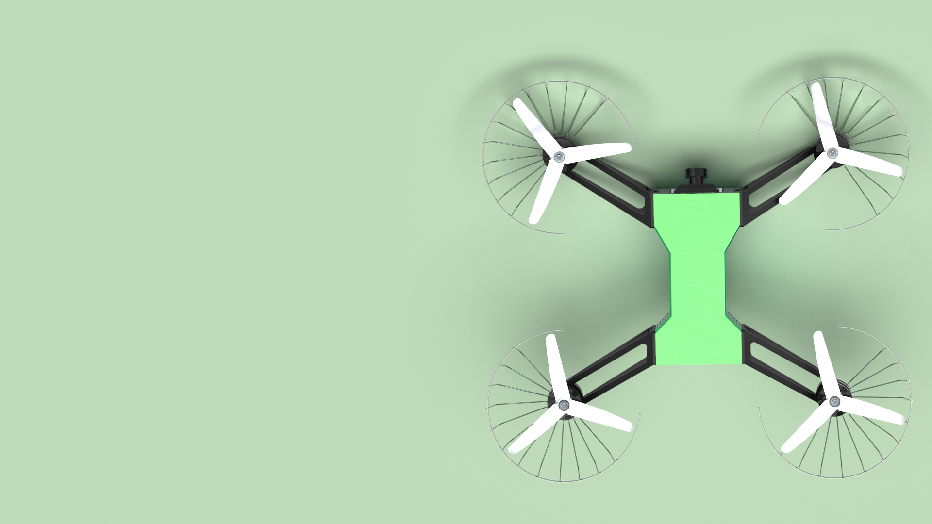
IAM3D DRONE

Slide 4
CONTENT
INTRODUCTION
RENDERING
DESIGNING
ANALYSIS
SLICING

Slide 5
INTRODUCTION
IN PREPARATION FOR THE UPCOMING ASME IAM3D COMPETITION, I DECIDED TO MAKE USE OF THIS OPPORTUNITY TO DESIGN A DRONE WHICH SATISFIES THE CONDITIONS GIVEN IN THE IAM3D RULE BOOK.

Slide 6
THE DESIGN IS RENDERED IN A SOFTWARE CALLED KEYSHOT

Slide 7
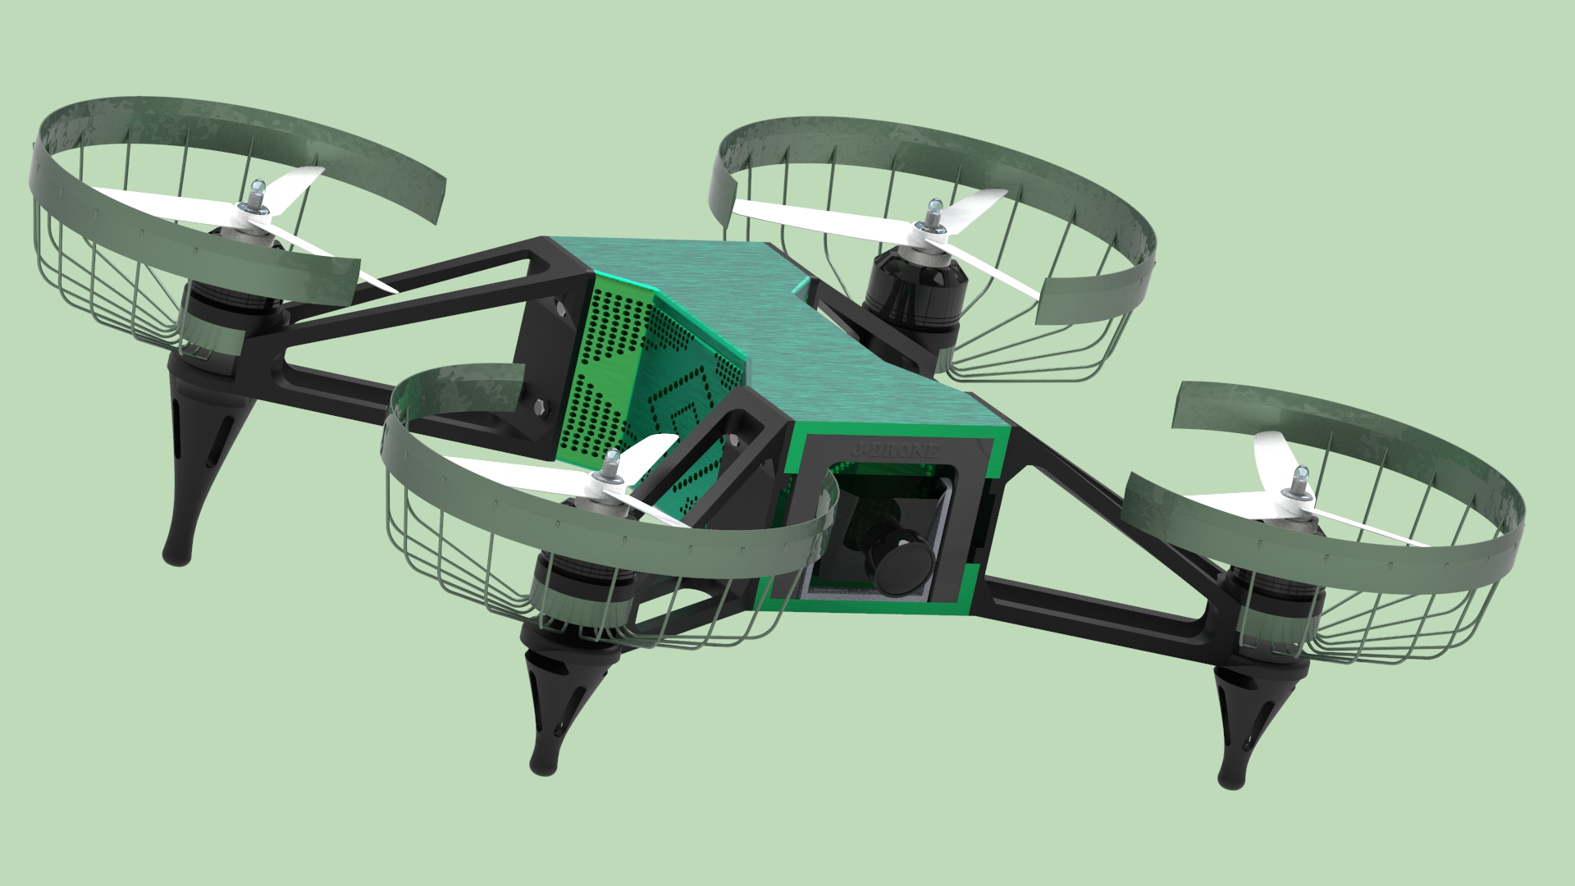

Slide 8
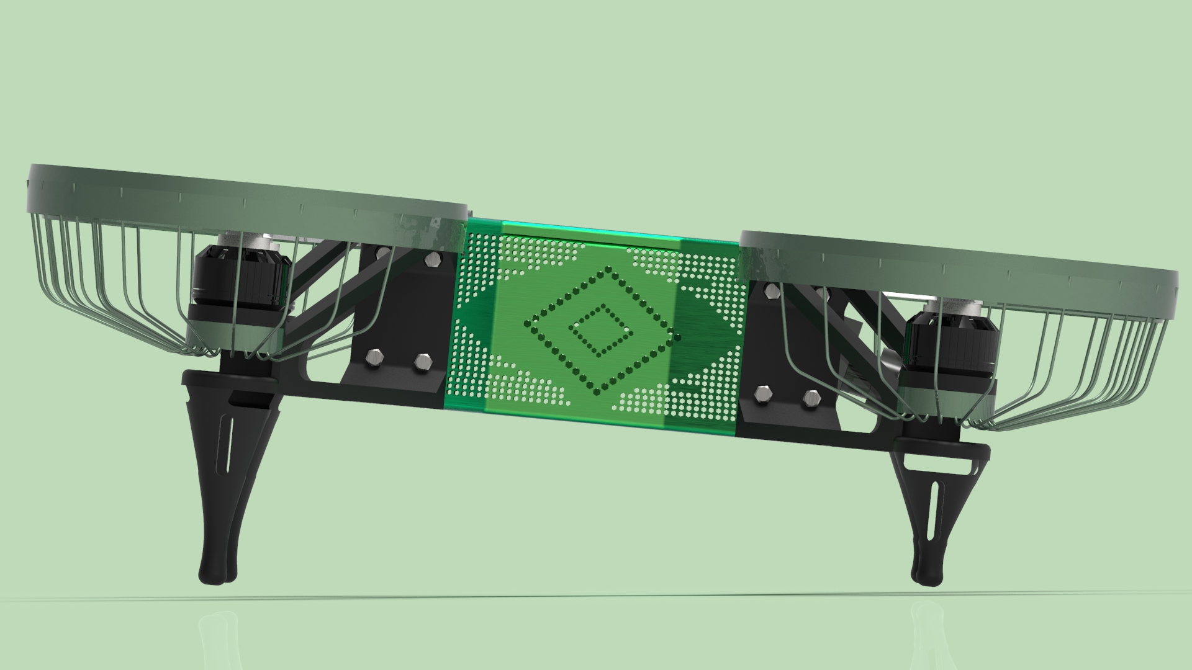

Slide 9
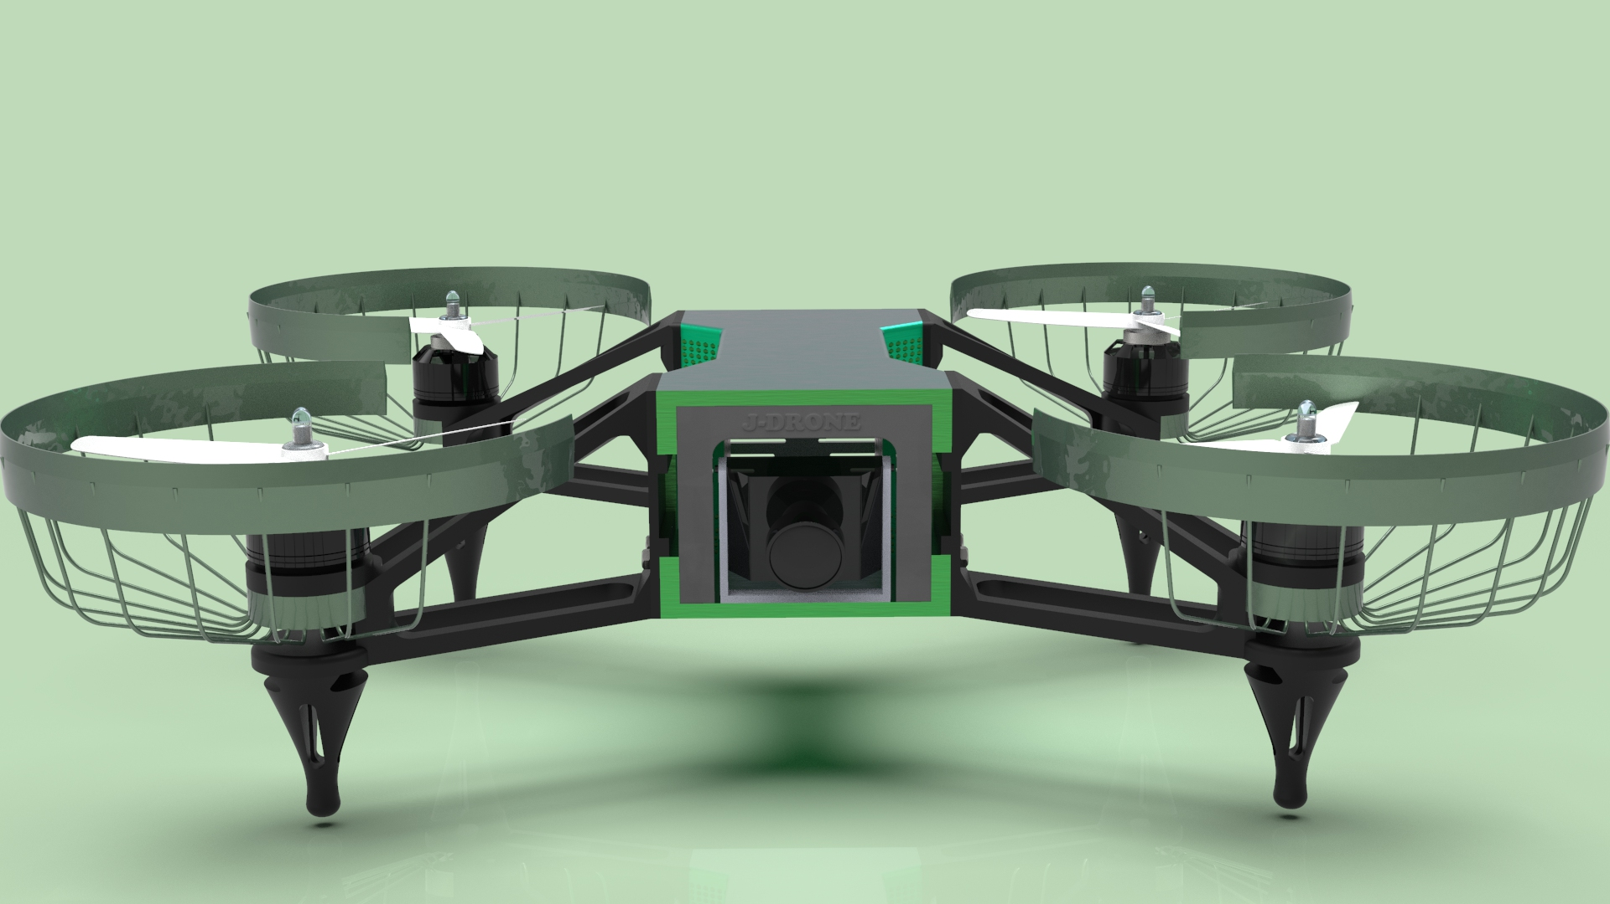

Slide 10
MADE A PROMO VIDEO USING KEYSHOT ANIMATION AND PREMIERE PRO

Slide 11
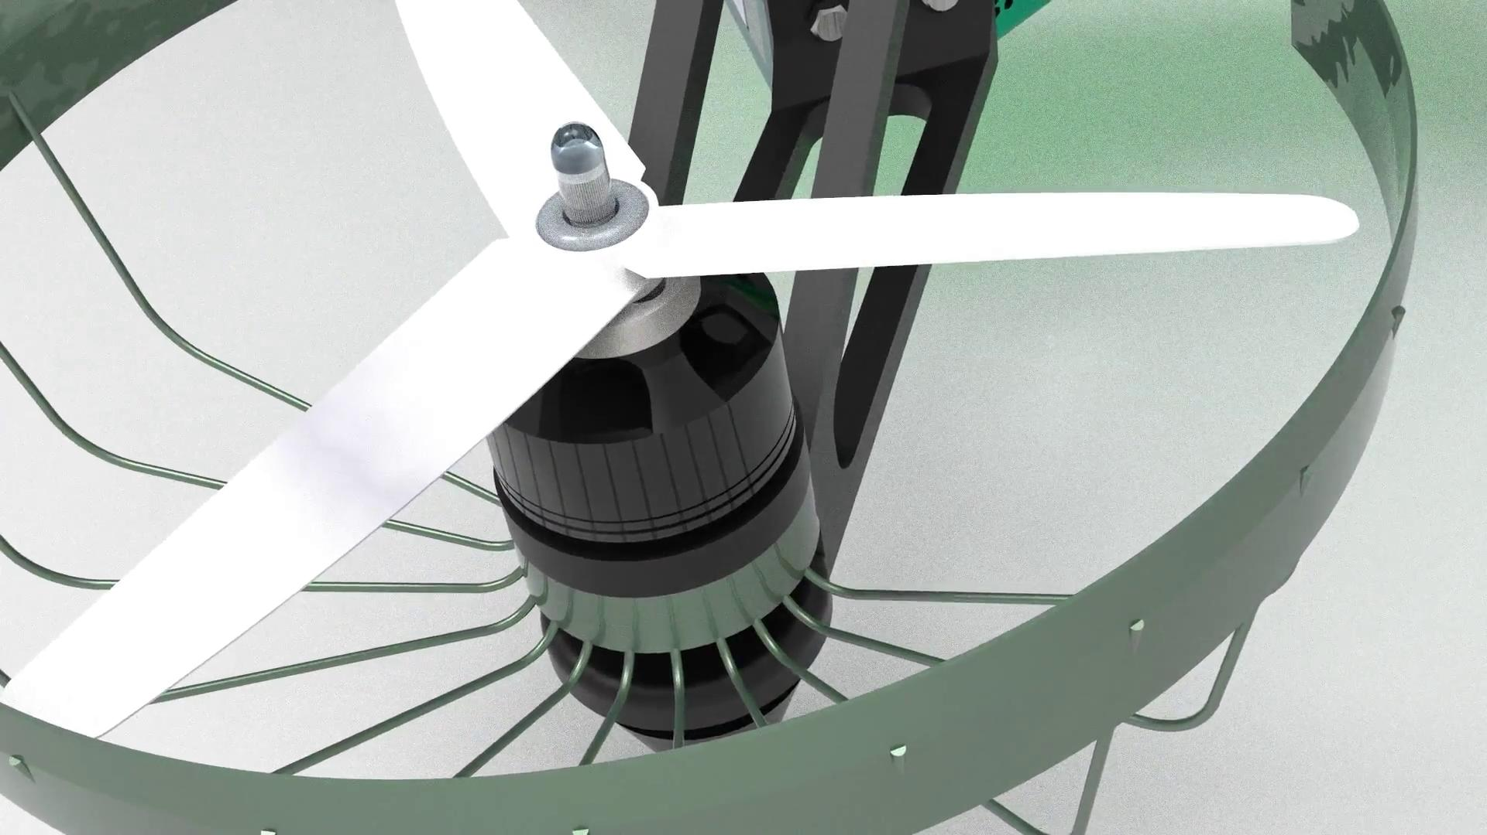

Slide 12
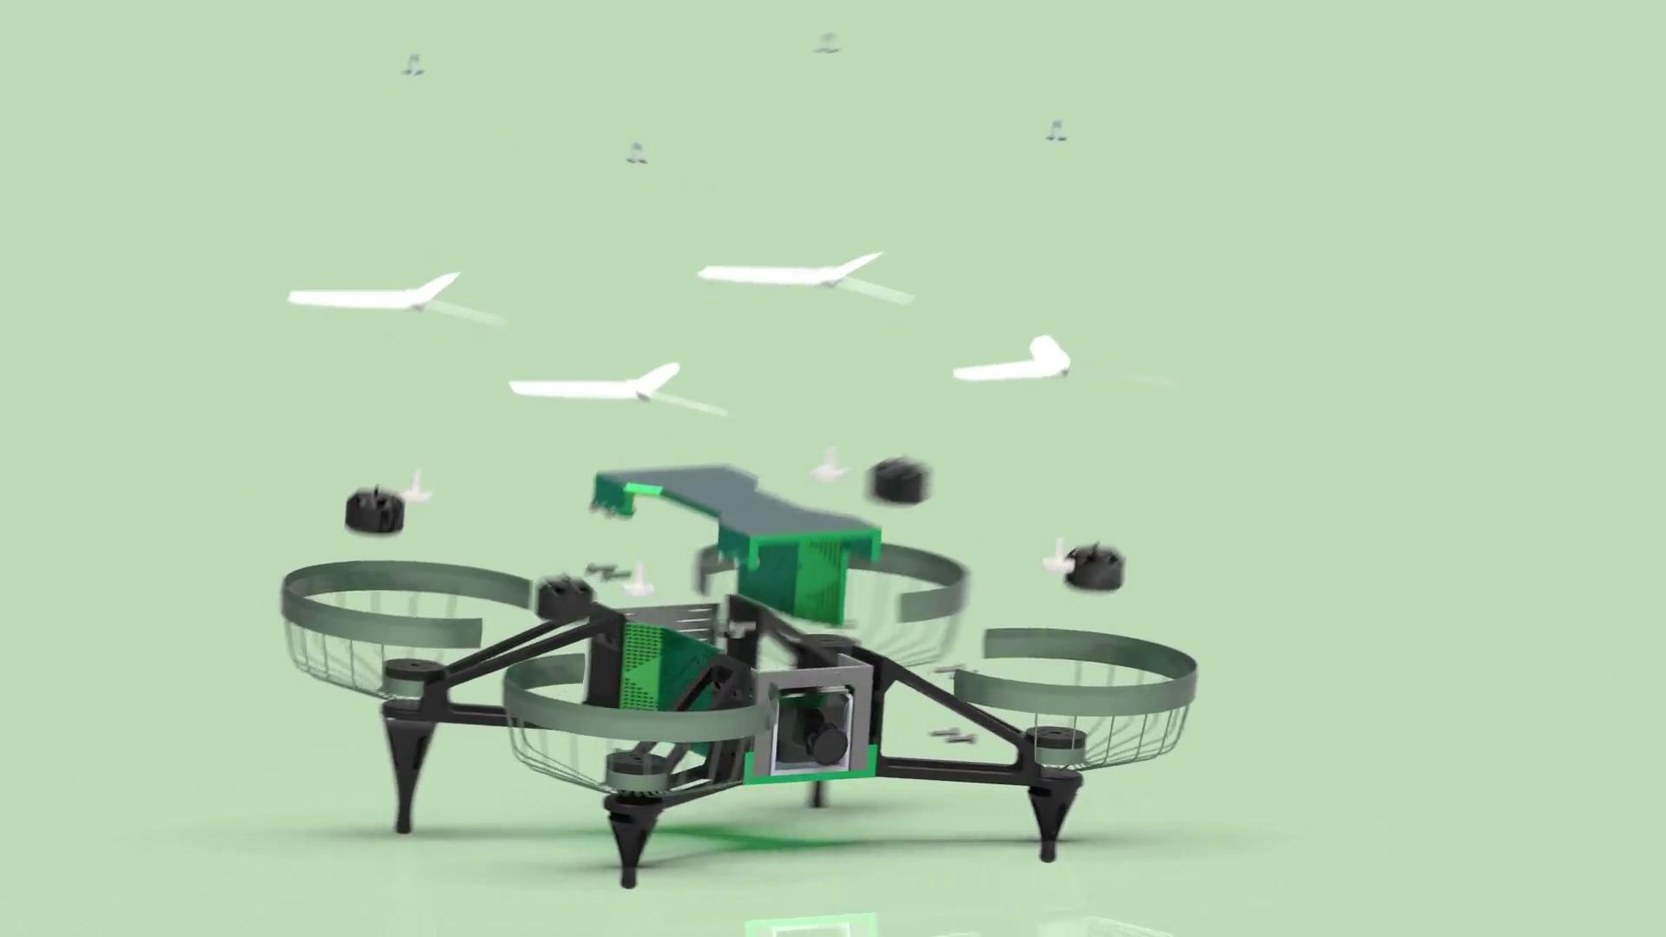
EXPLODED VIEW

Slide 13
THE DRONE WAS DESIGNED IN A CAD SOFTWARE CALLED SOLIDWORKS

Slide 14
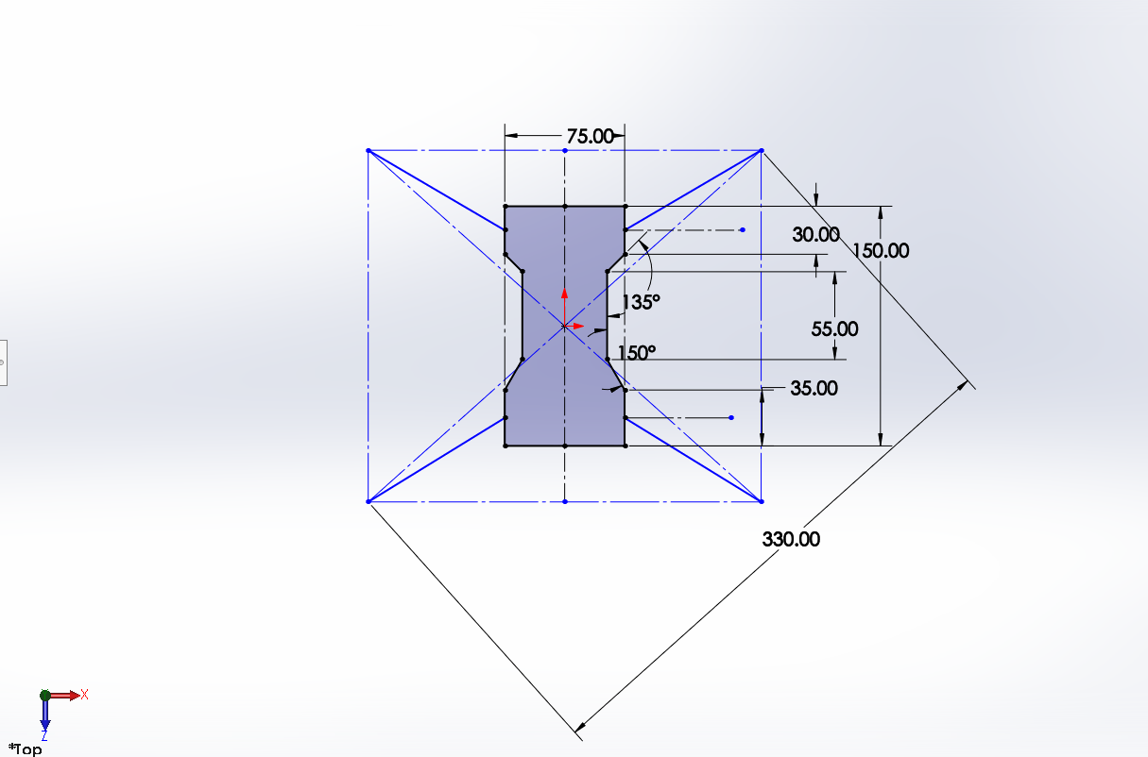
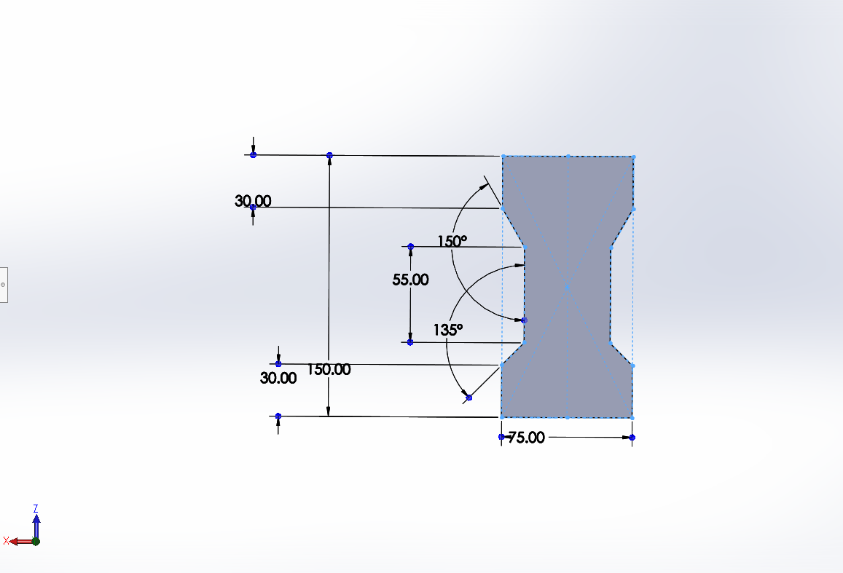
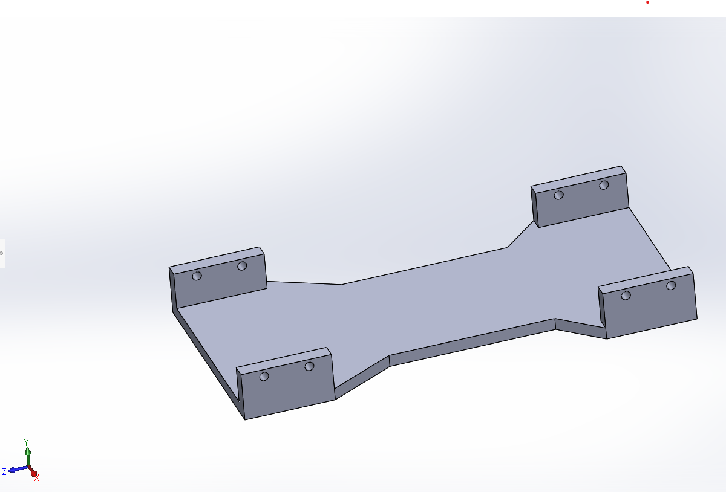
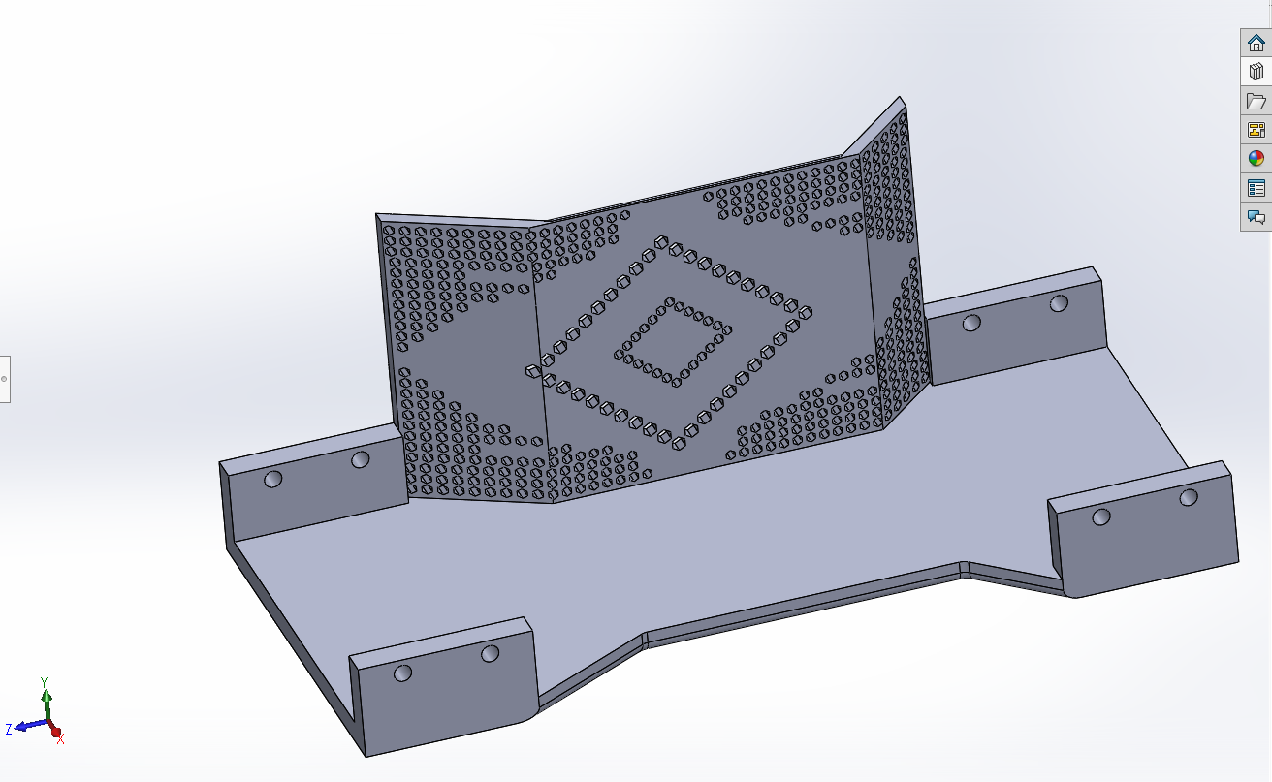

Slide 15
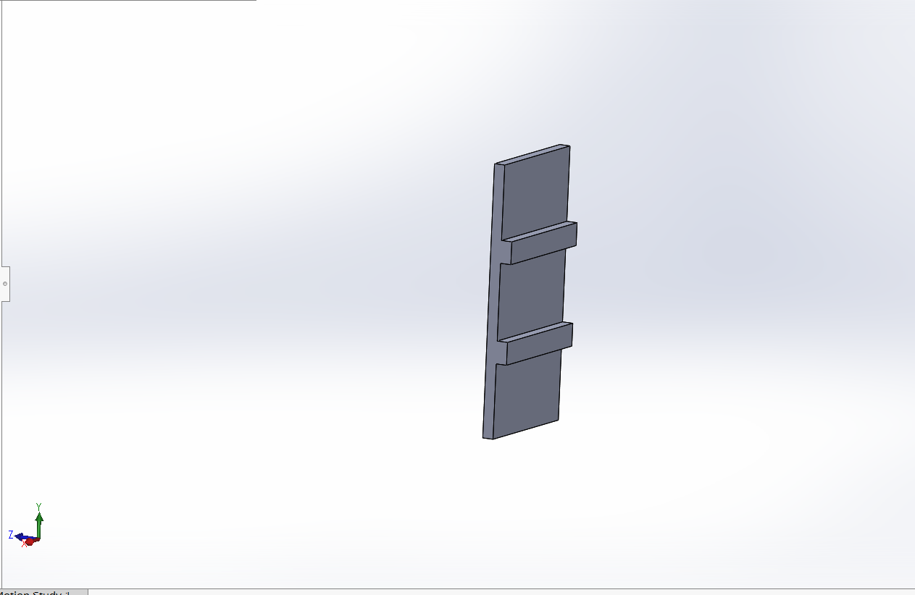
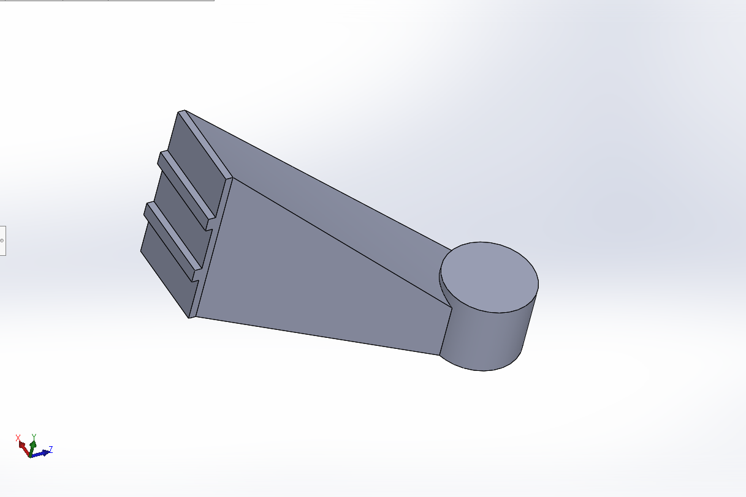
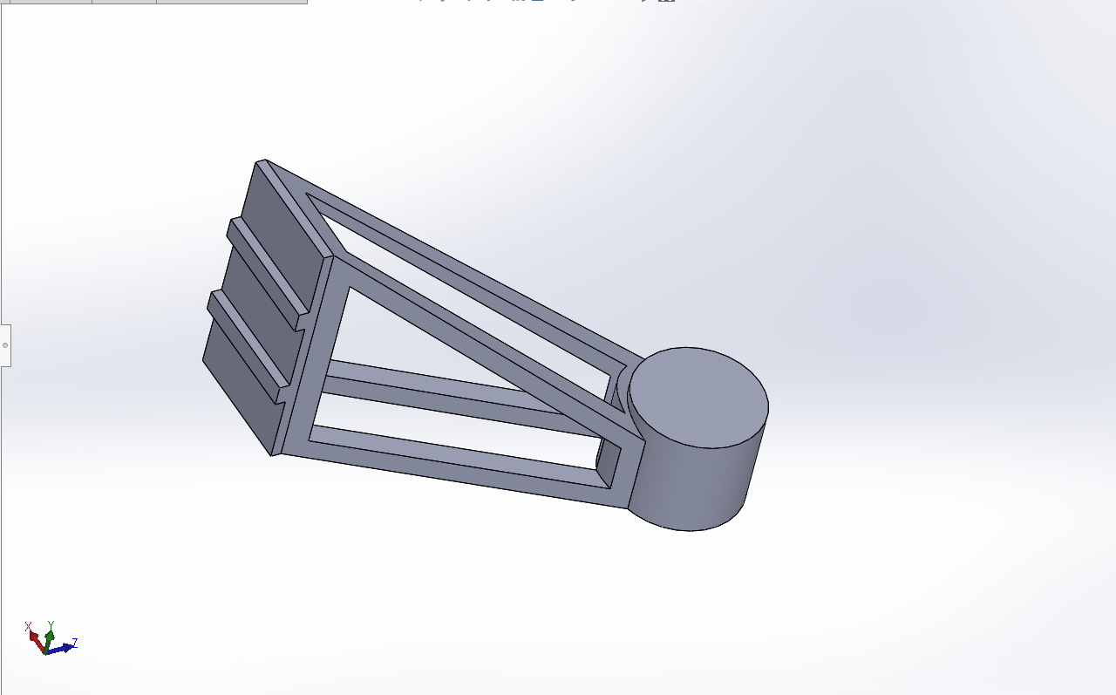
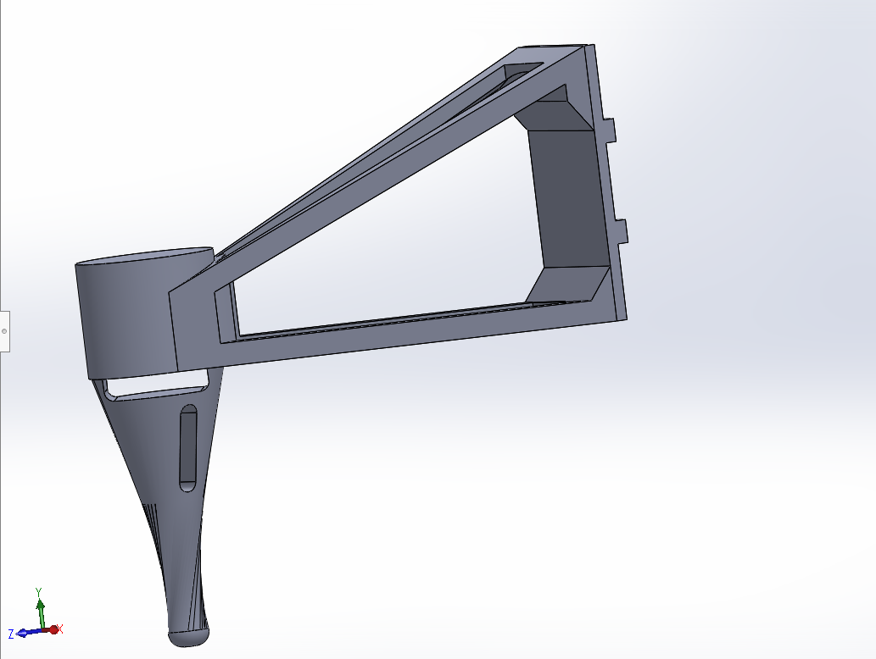

Slide 16
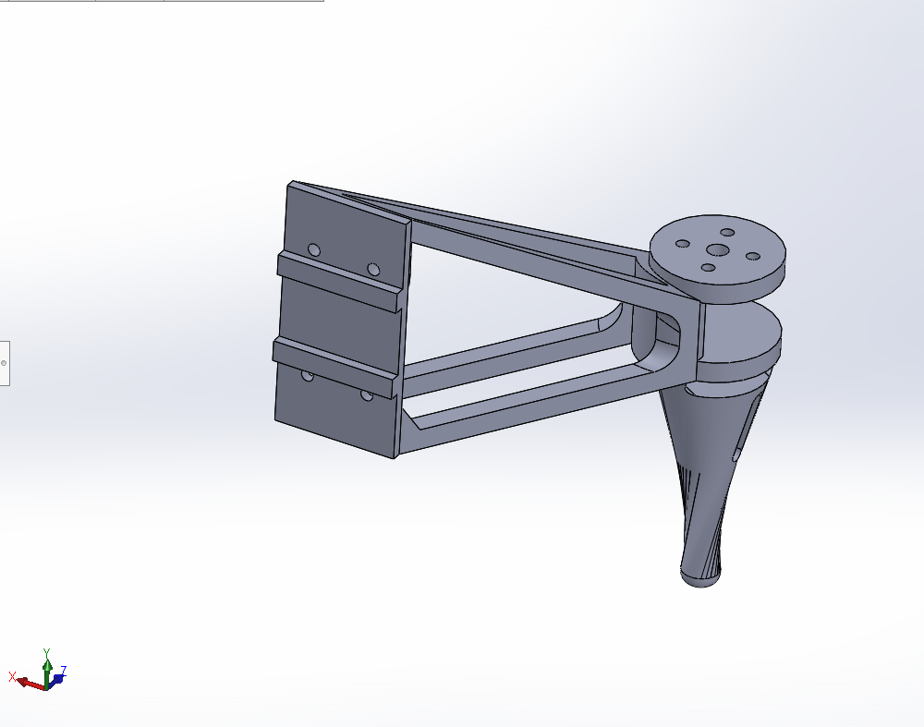
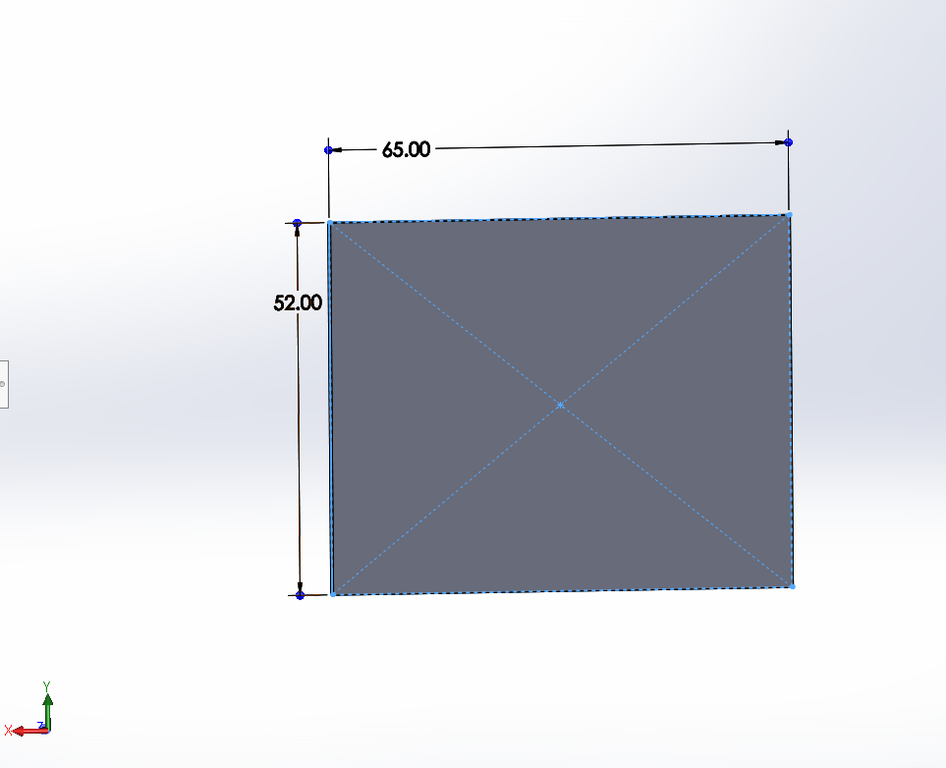
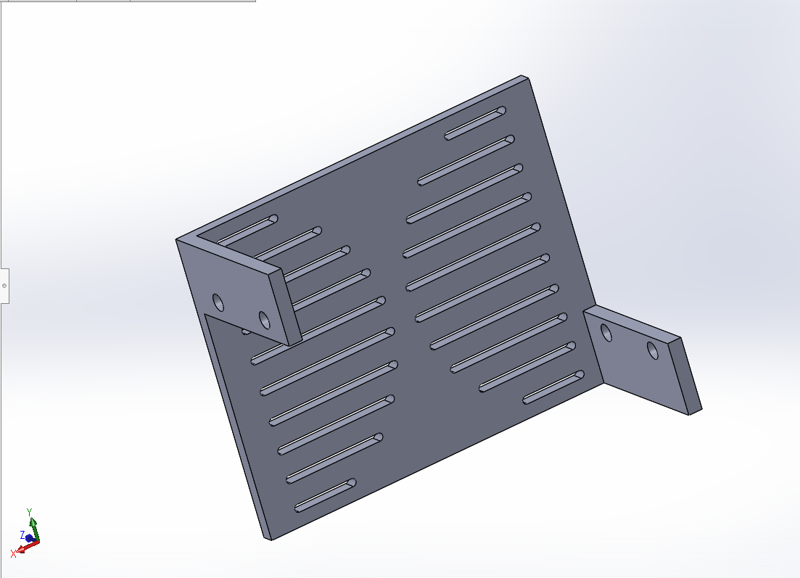
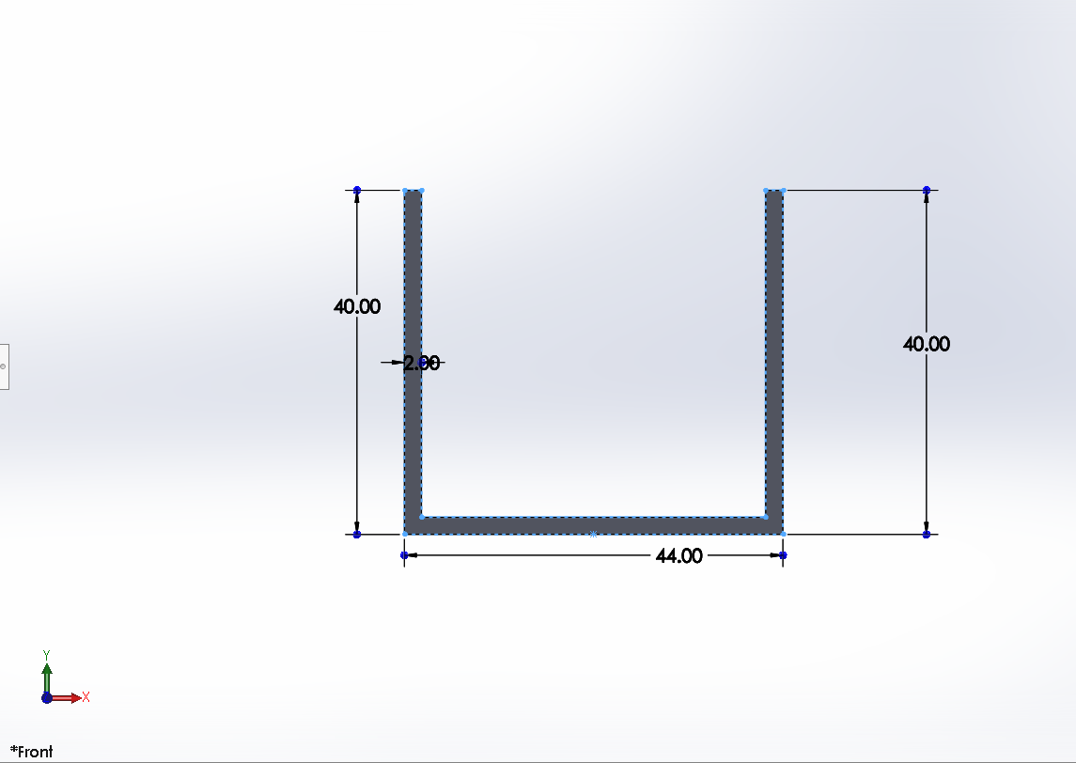

Slide 17
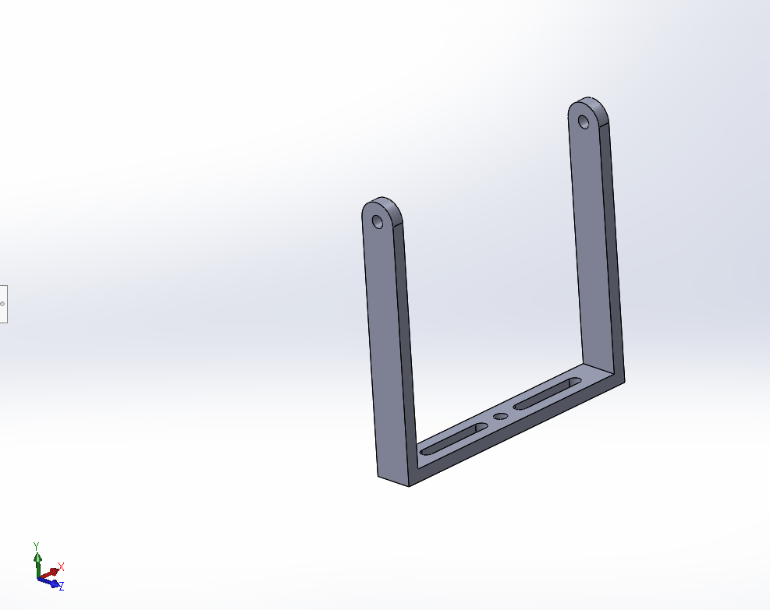
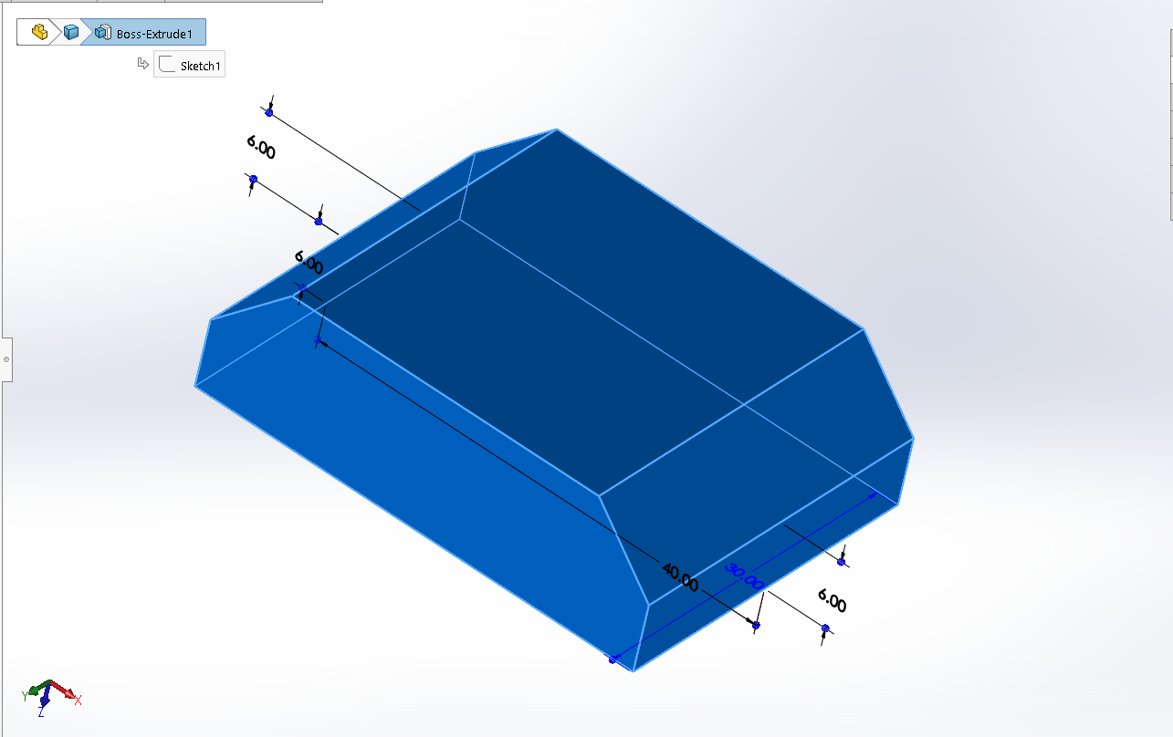
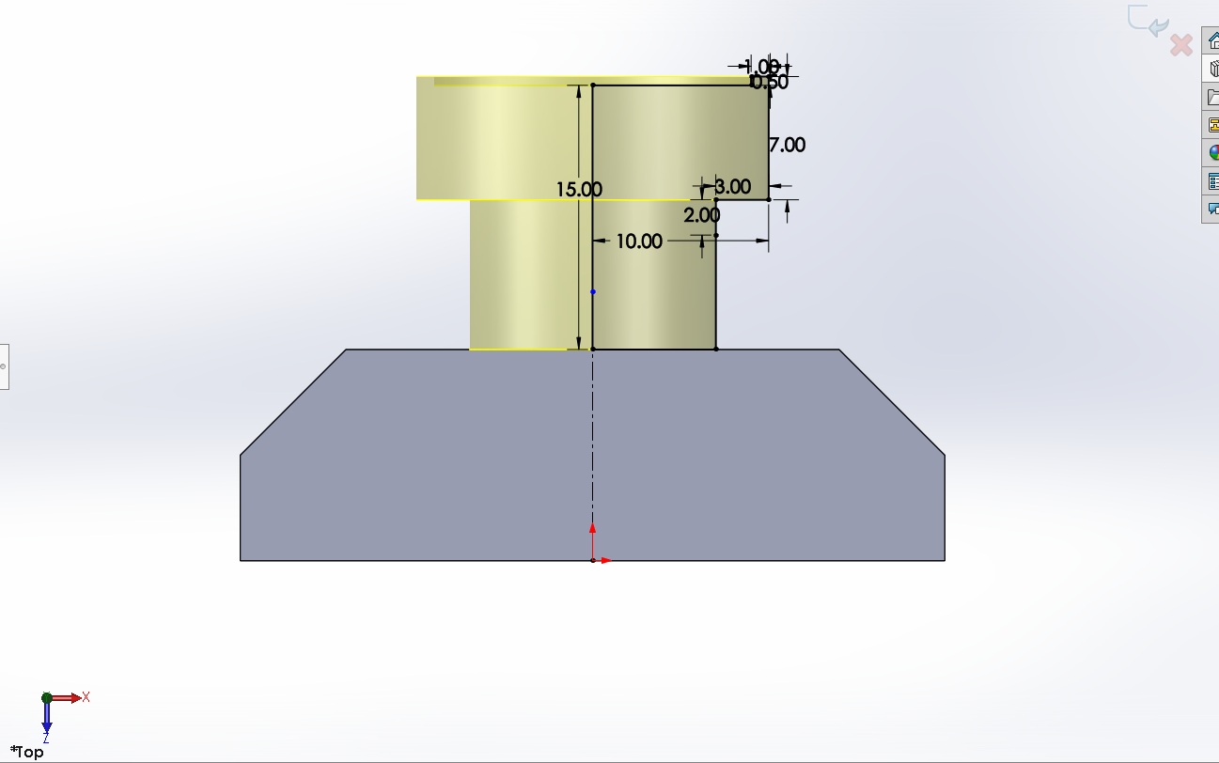
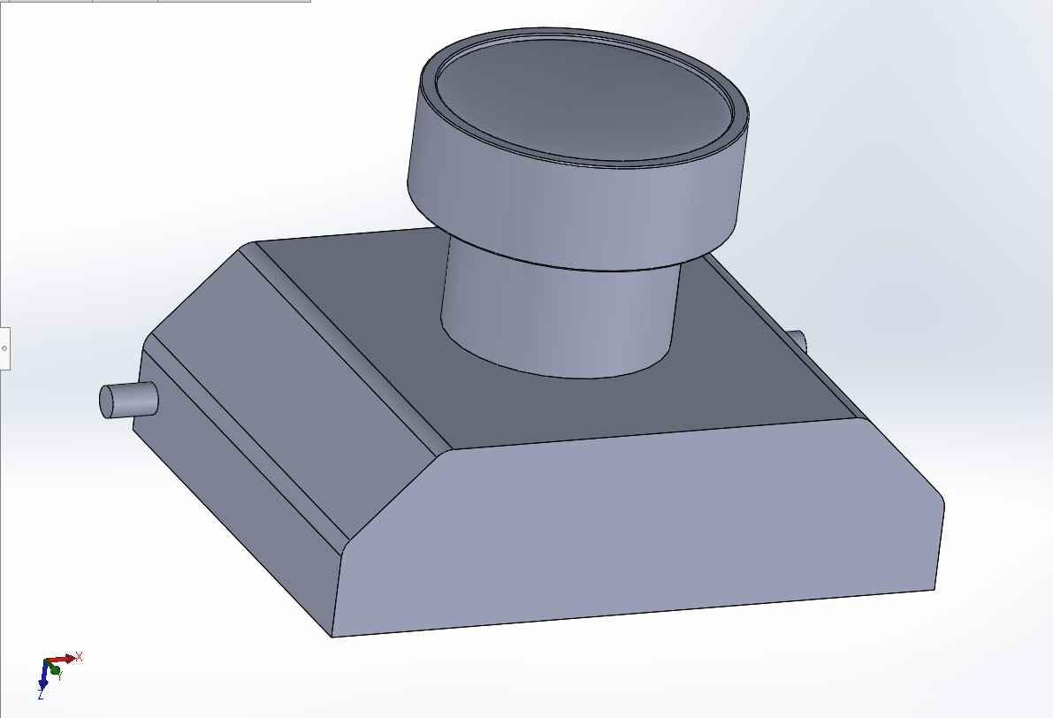

Slide 18
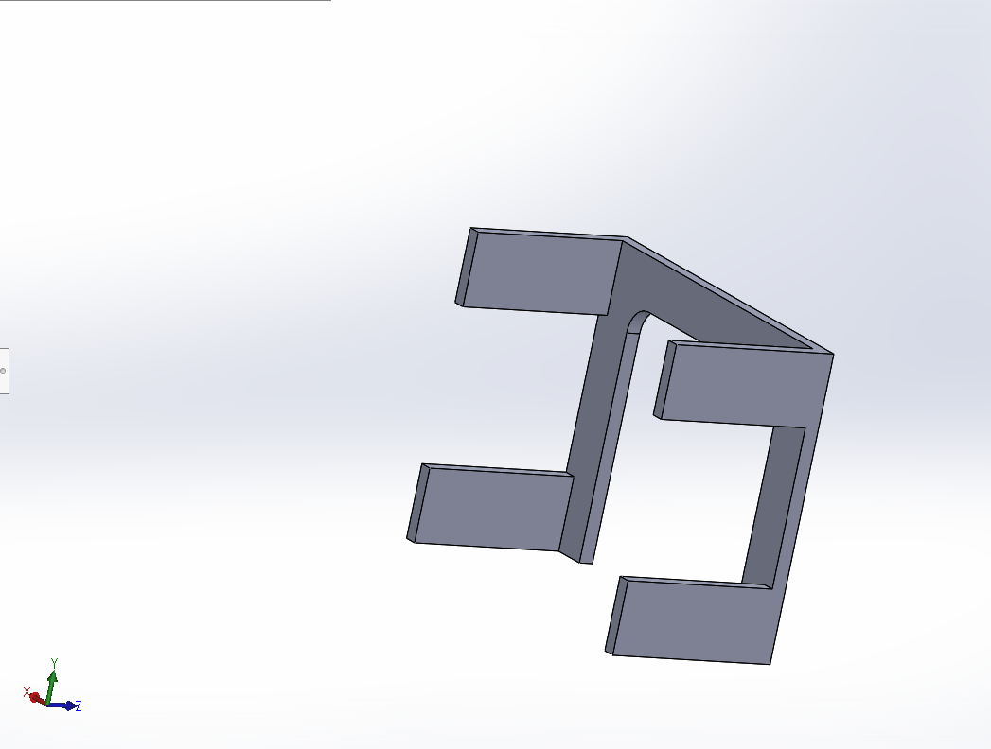
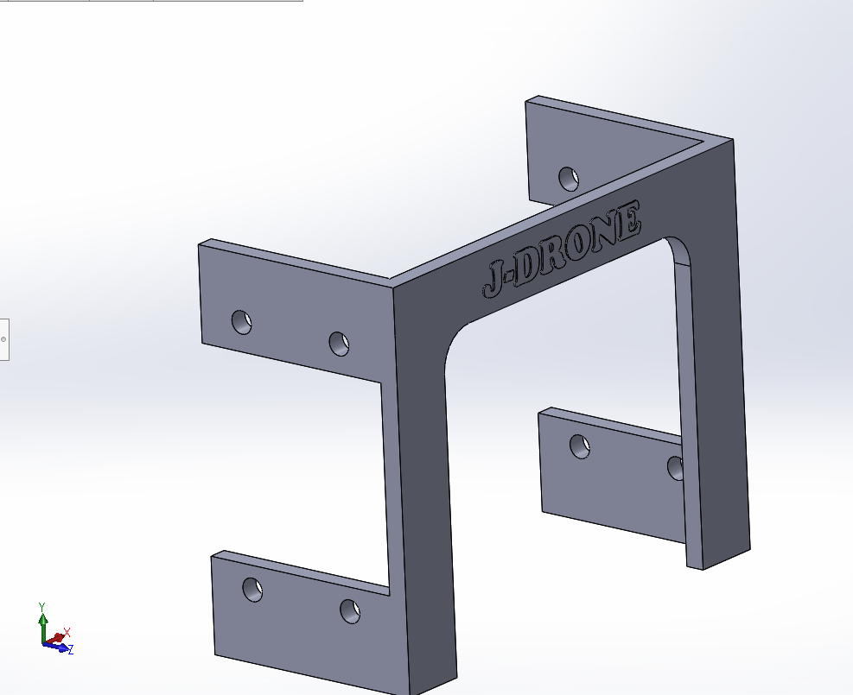
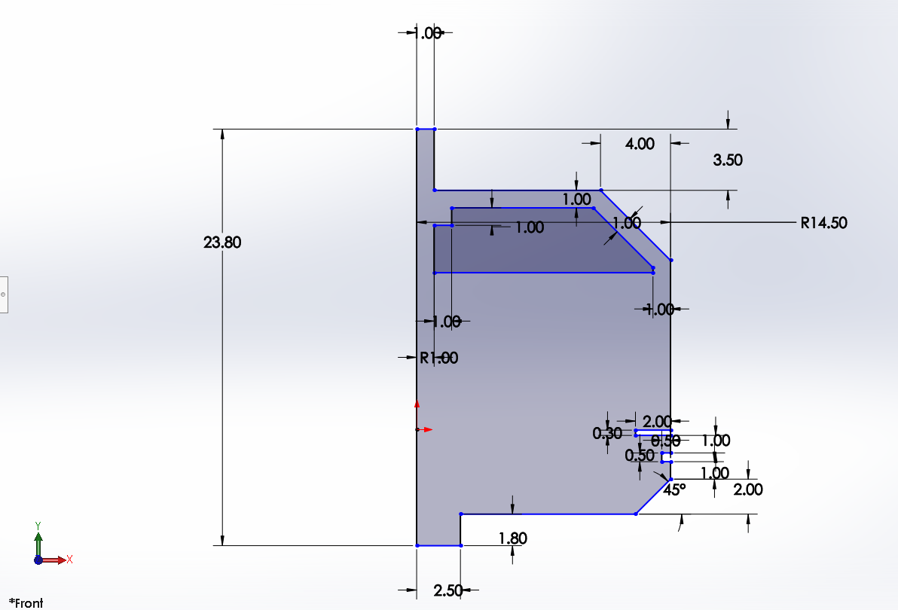
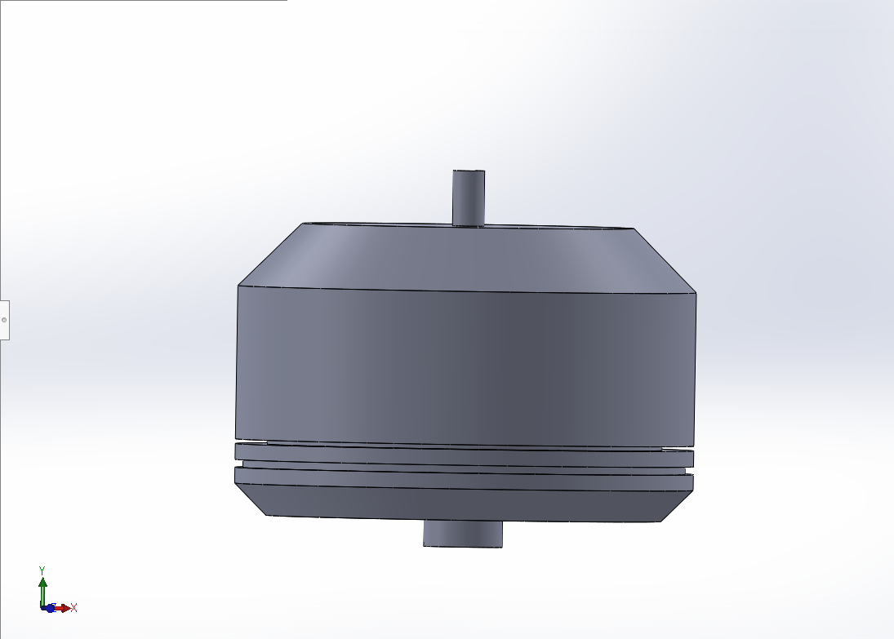

Slide 19
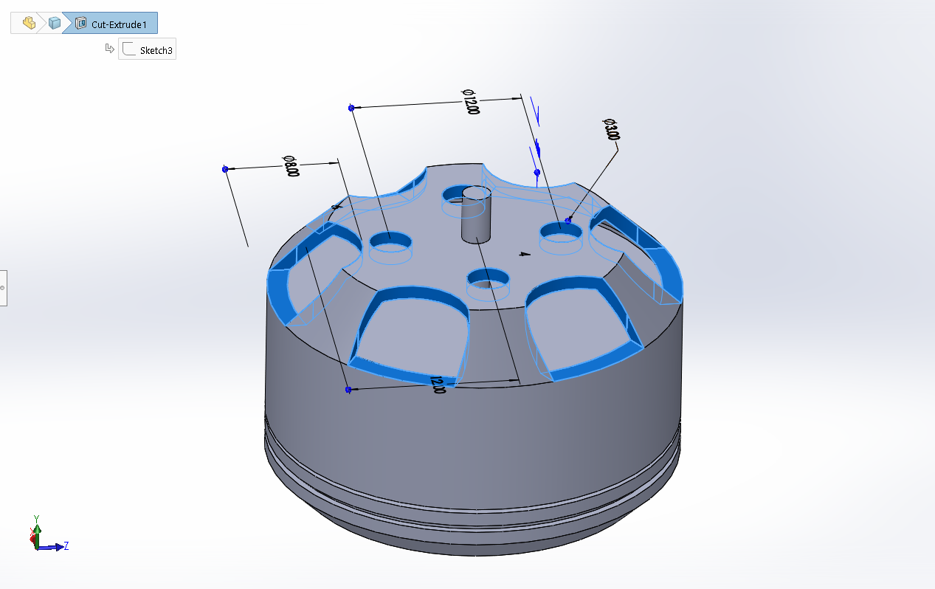
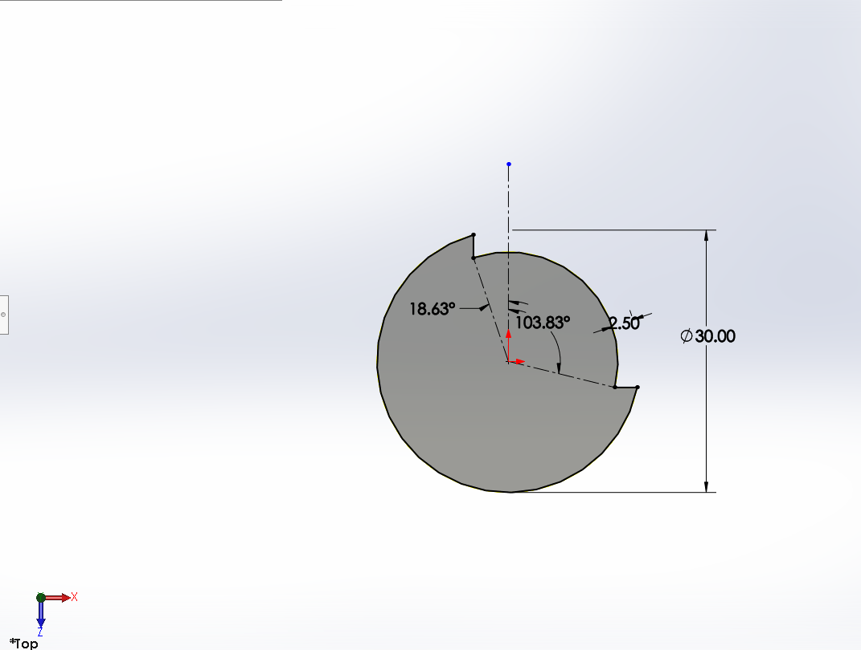
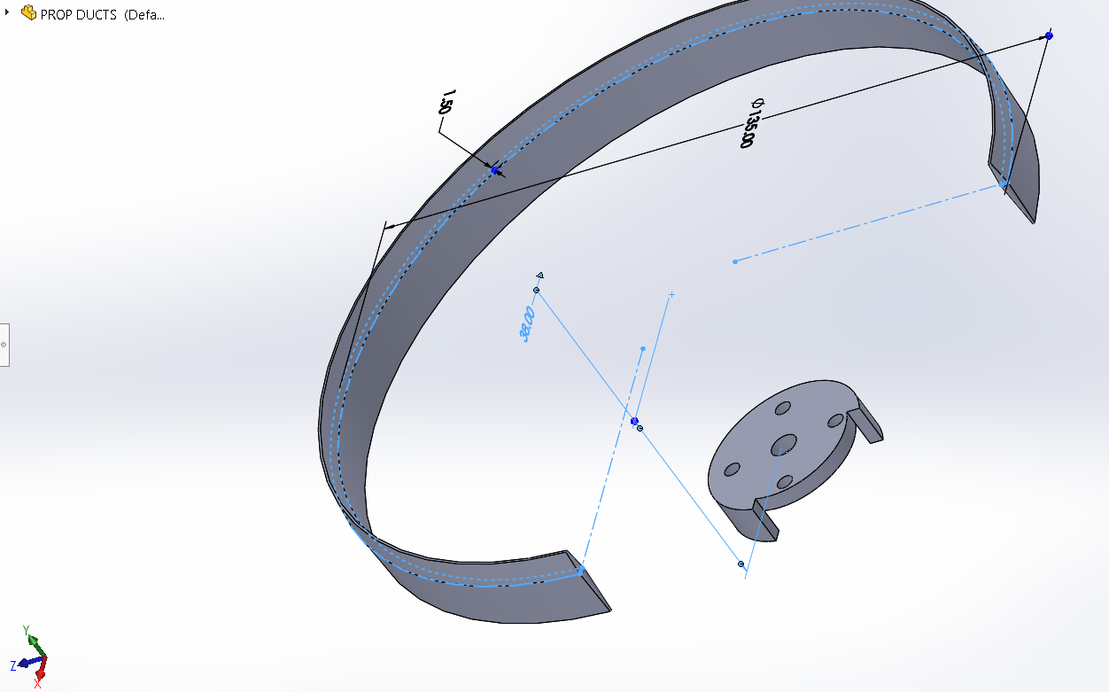
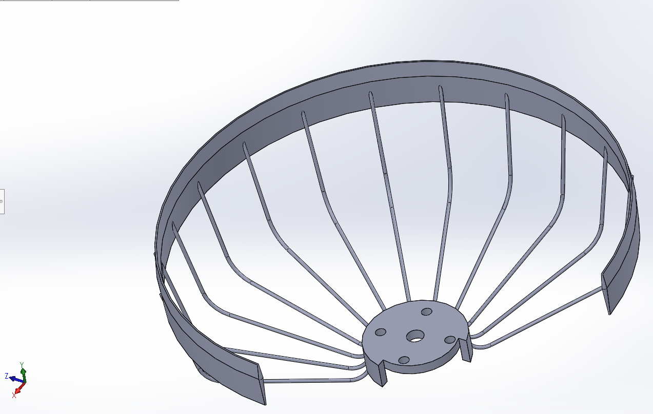

Slide 20
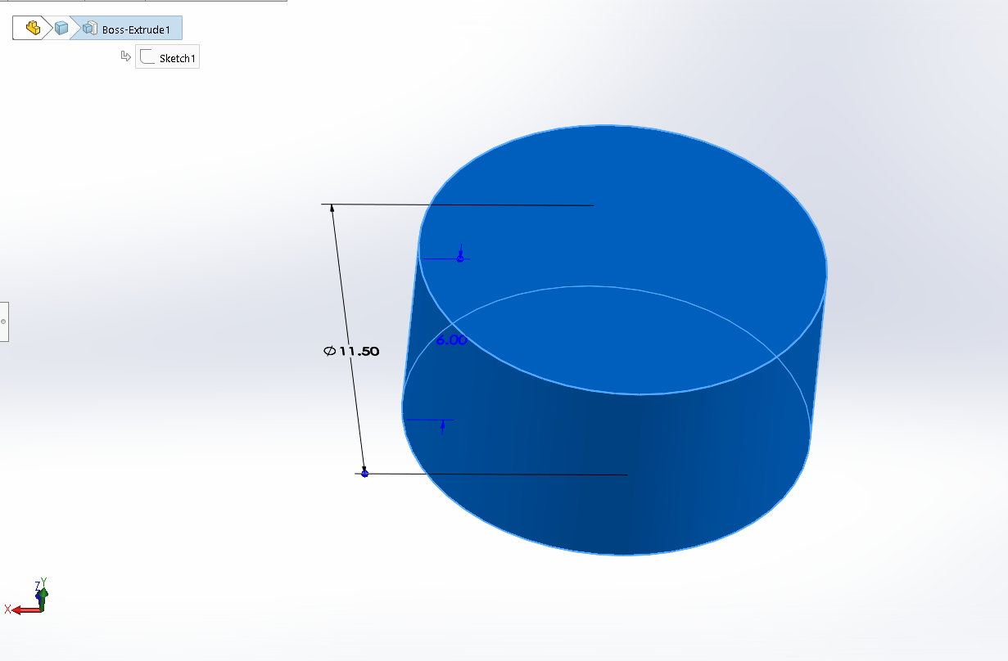
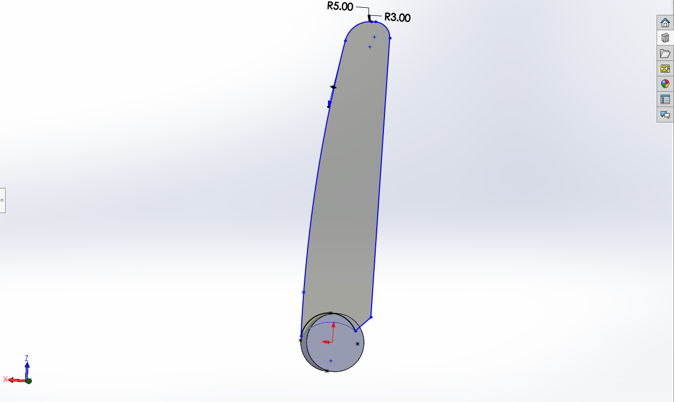
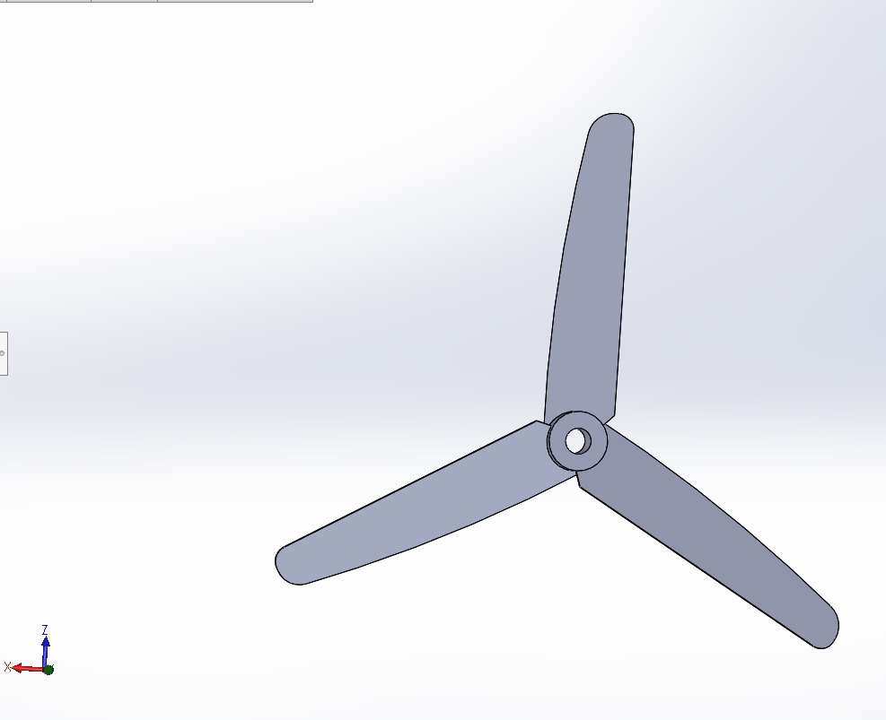
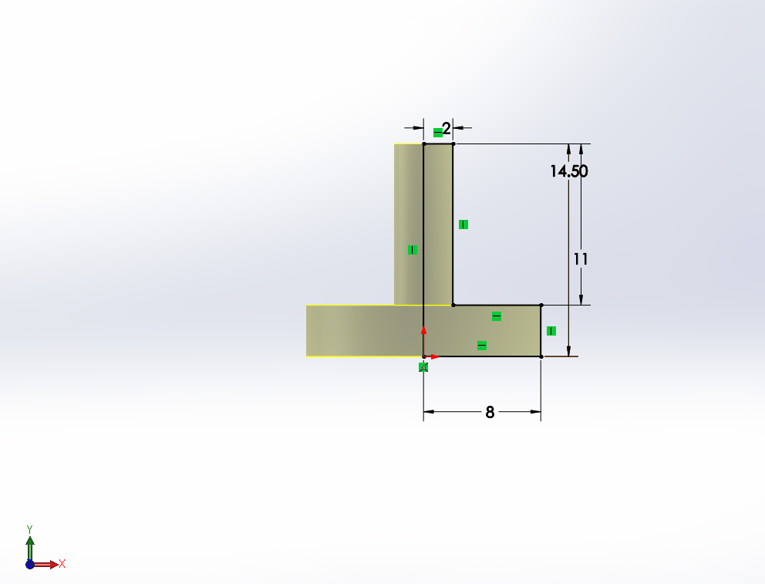

Slide 21
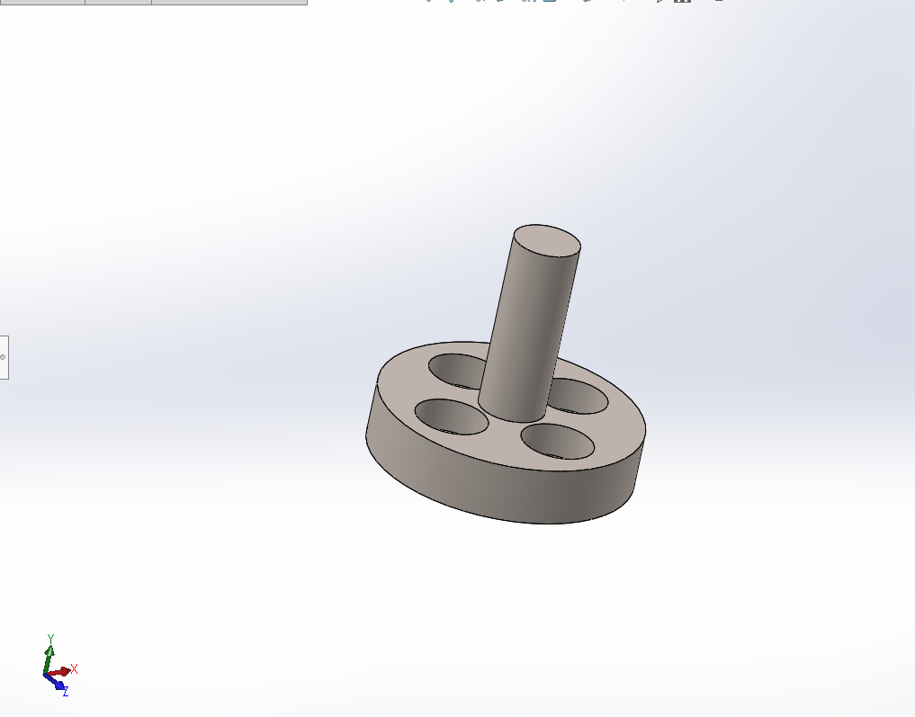
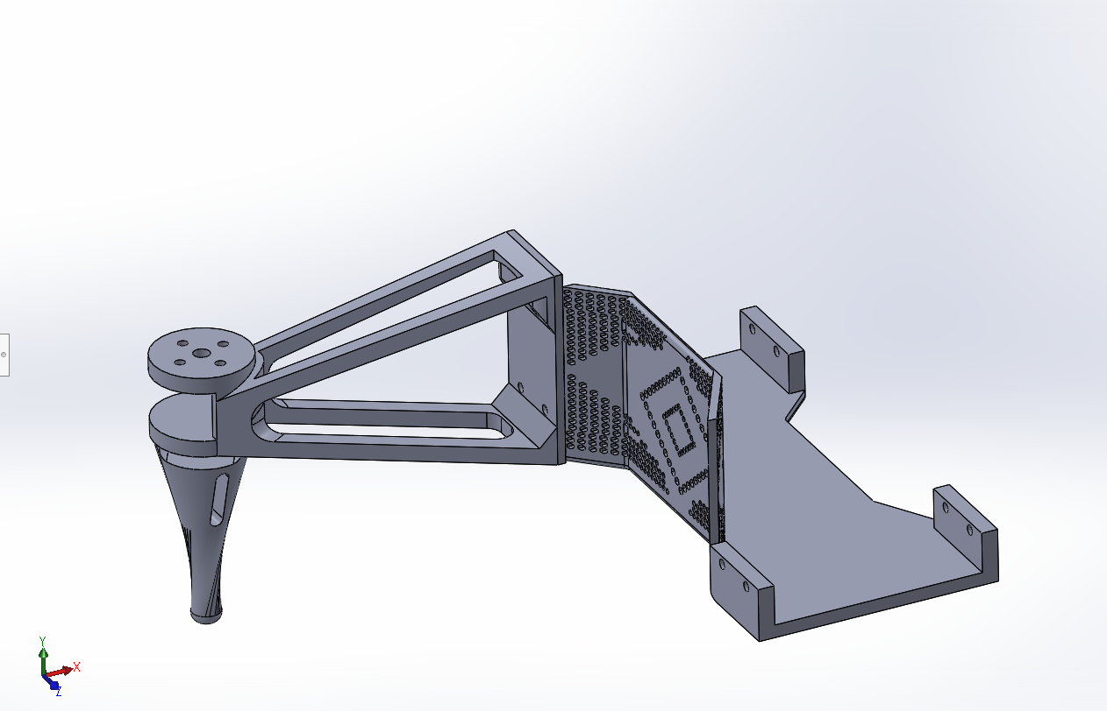
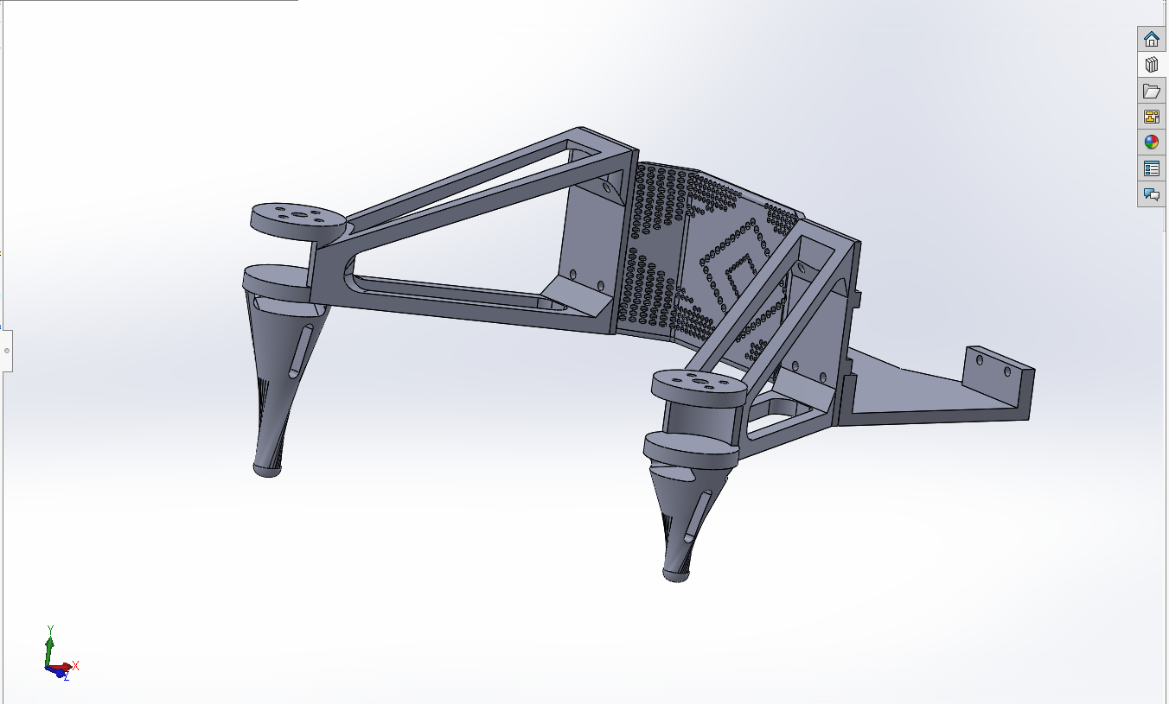
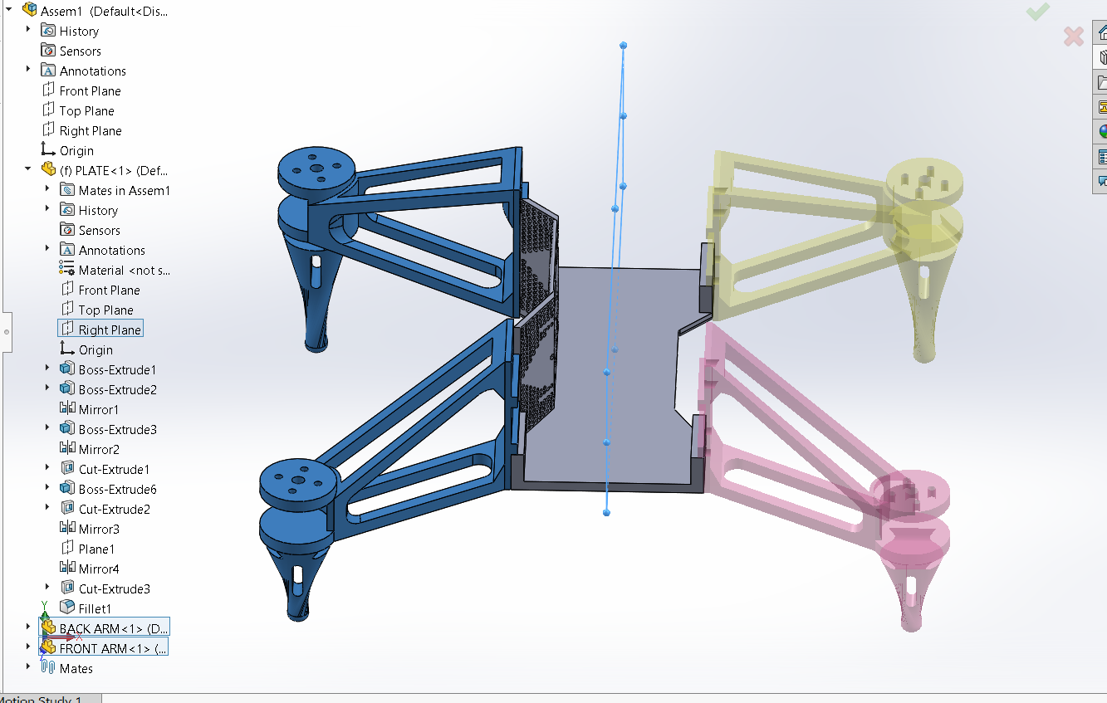

Slide 22
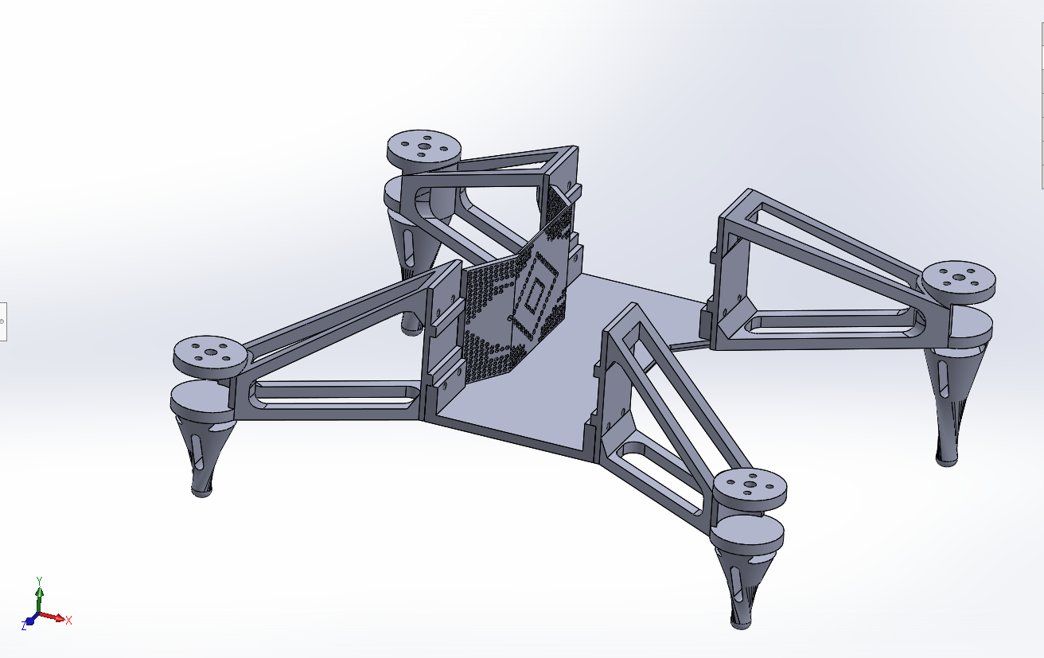
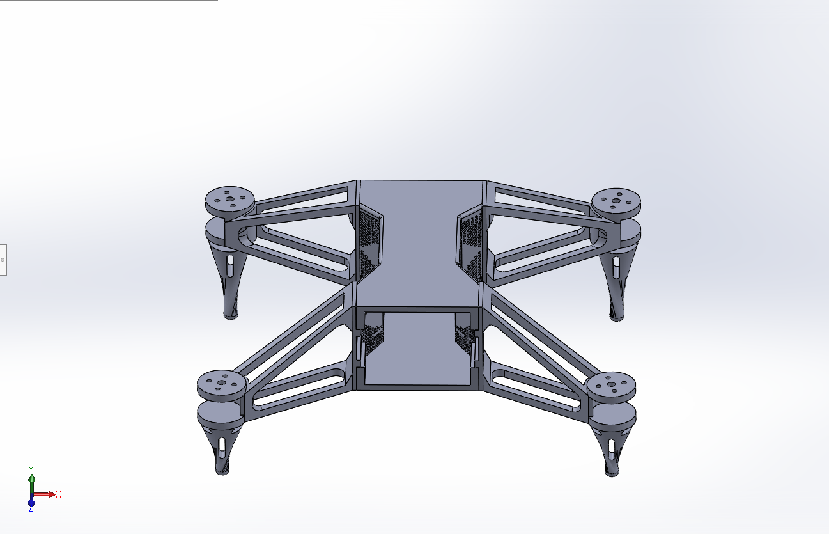
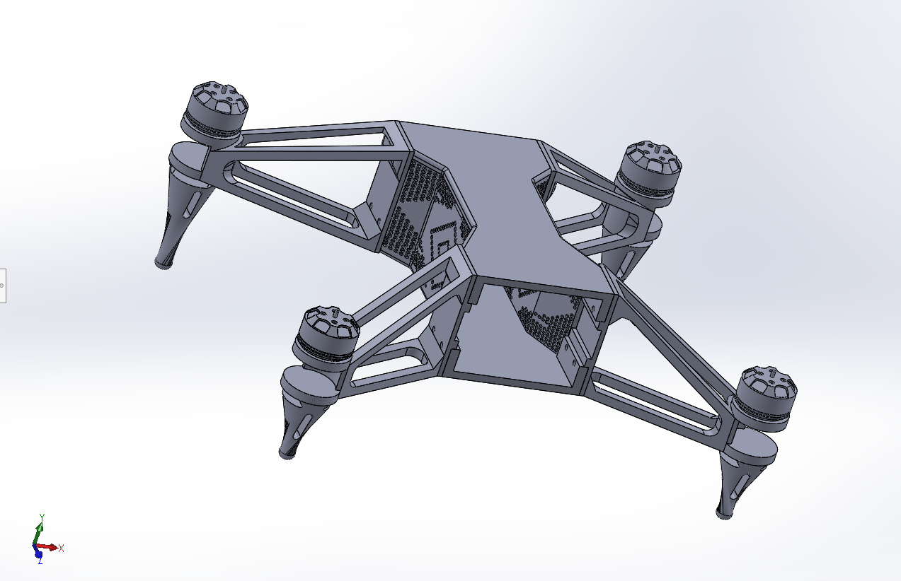
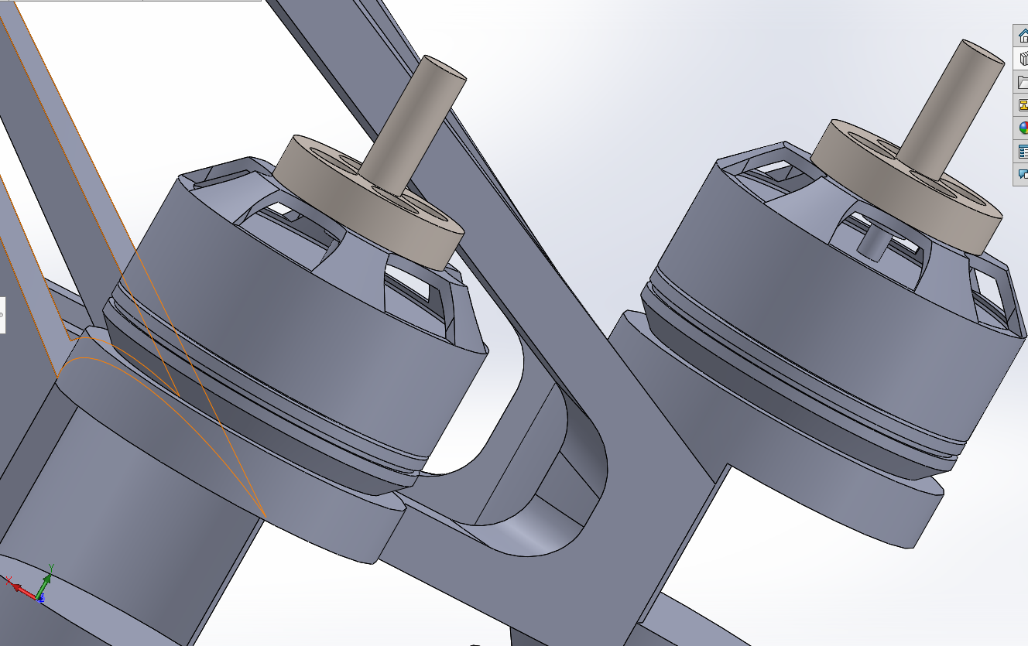

Slide 23
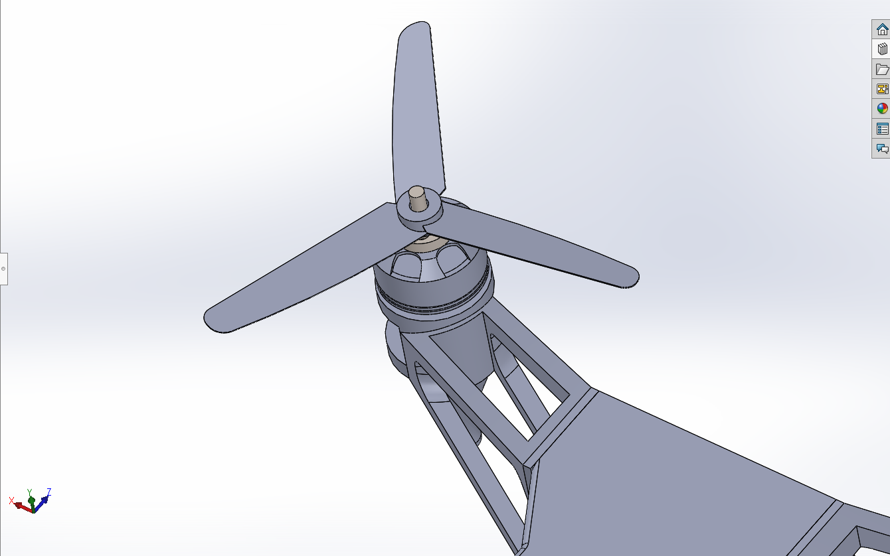
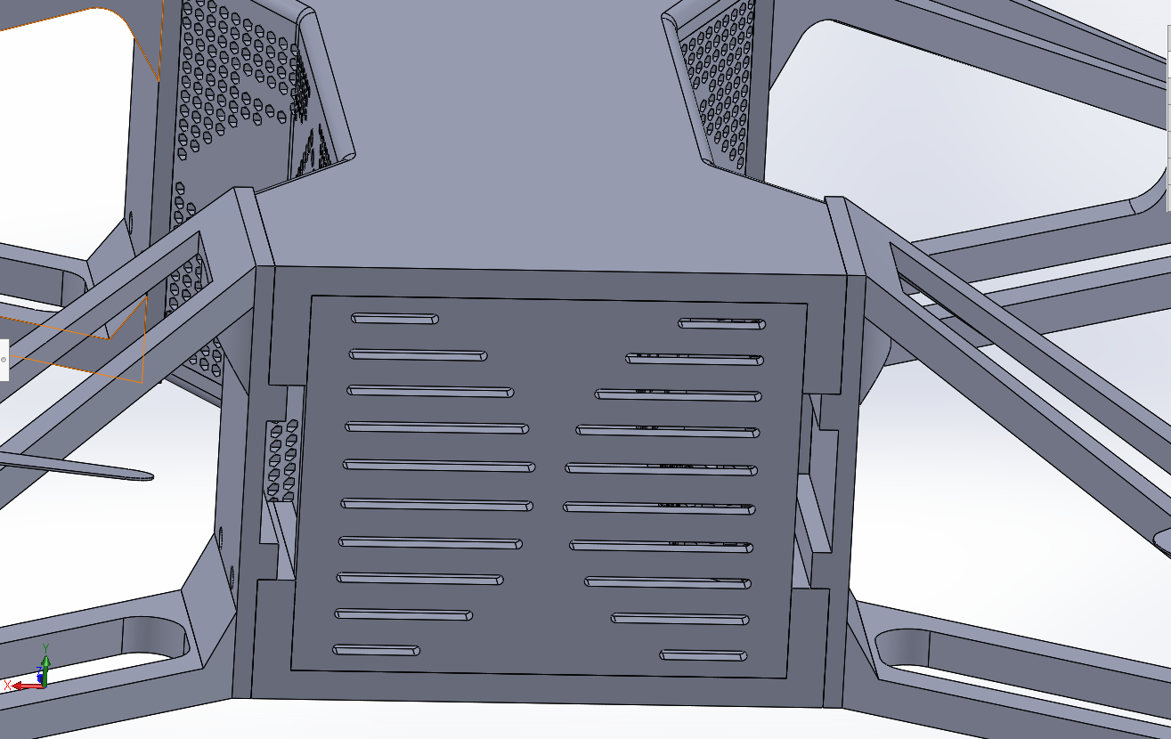
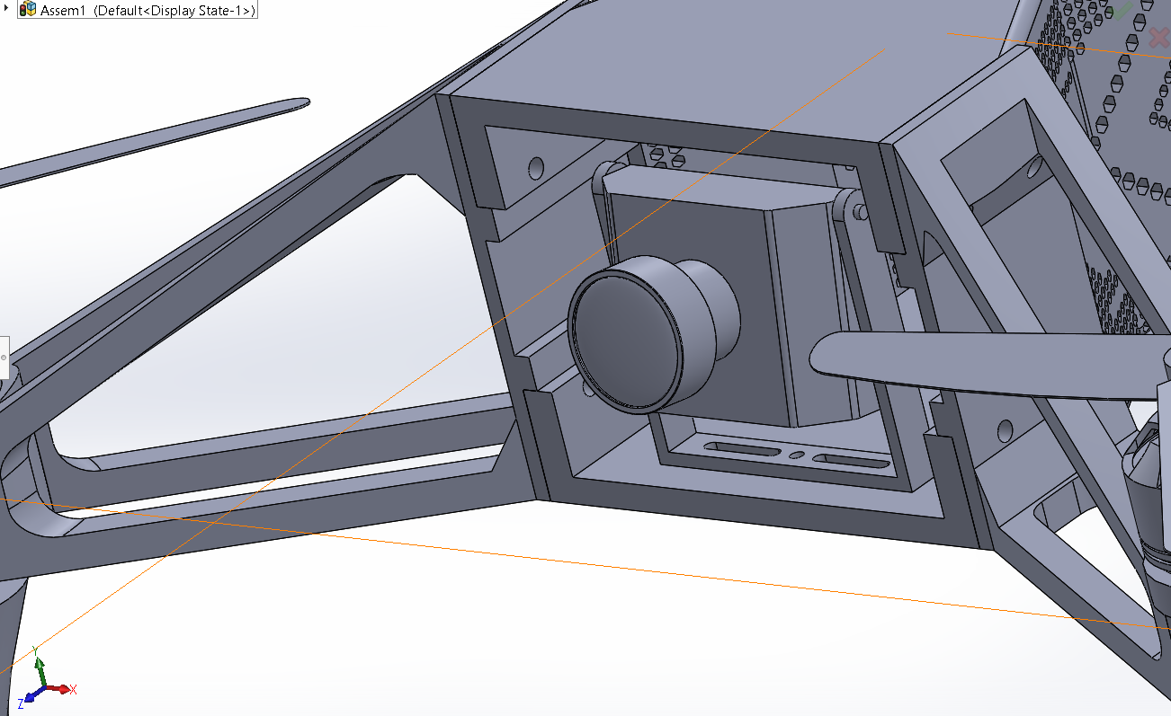
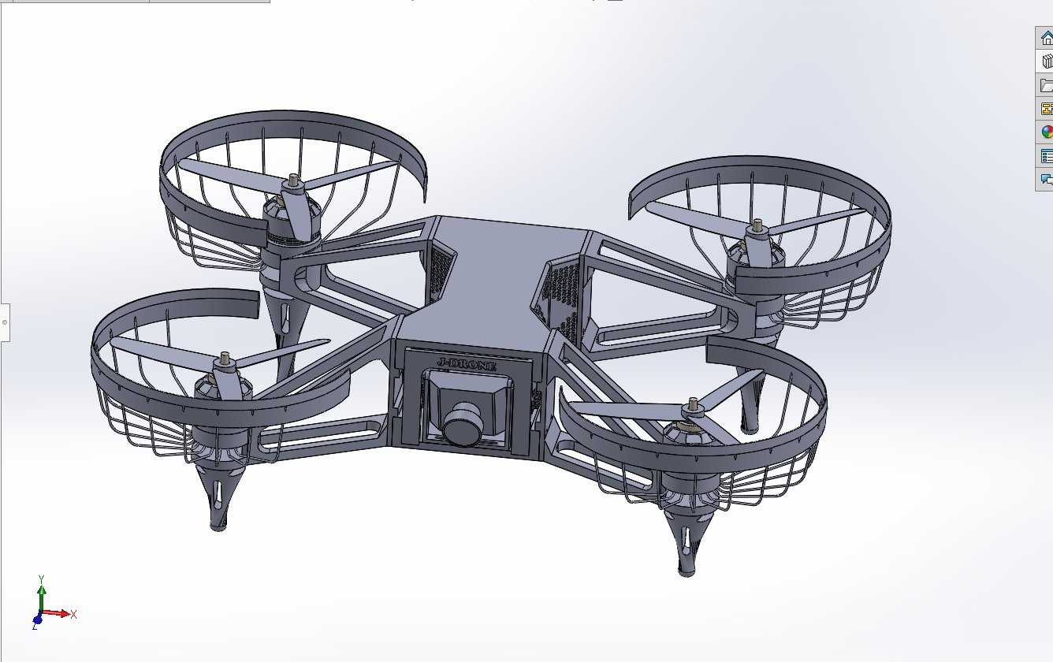

Slide 24
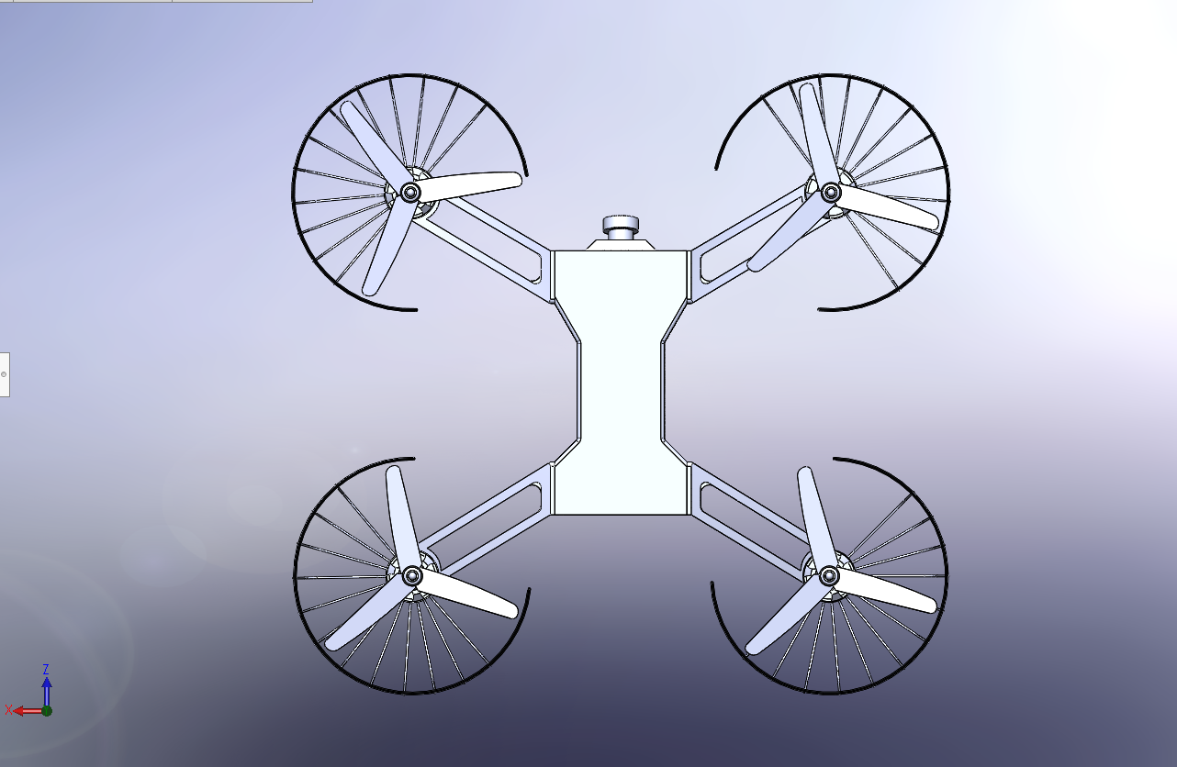
TOP VIEW

Slide 25
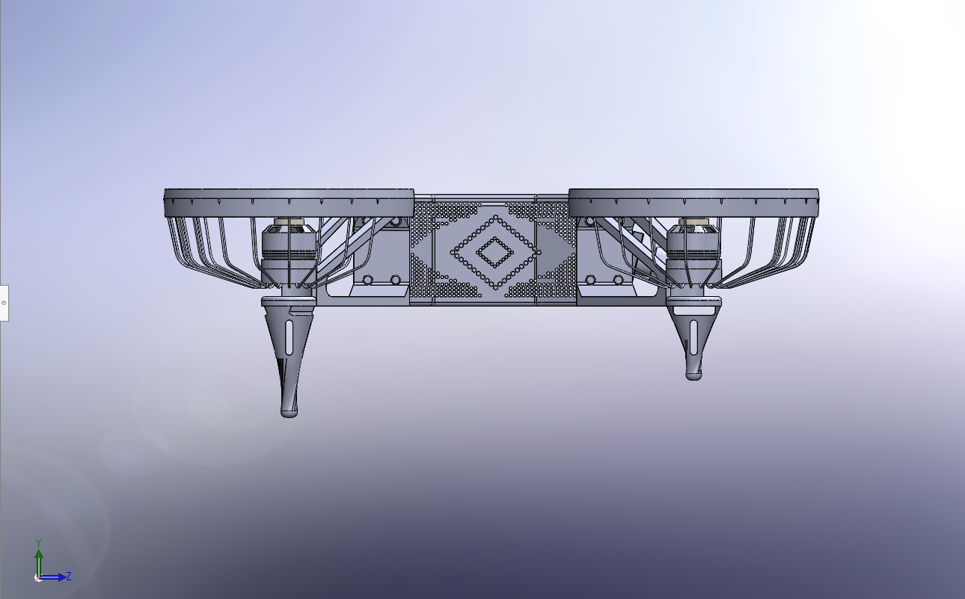
SIDE VIEW

Slide 26
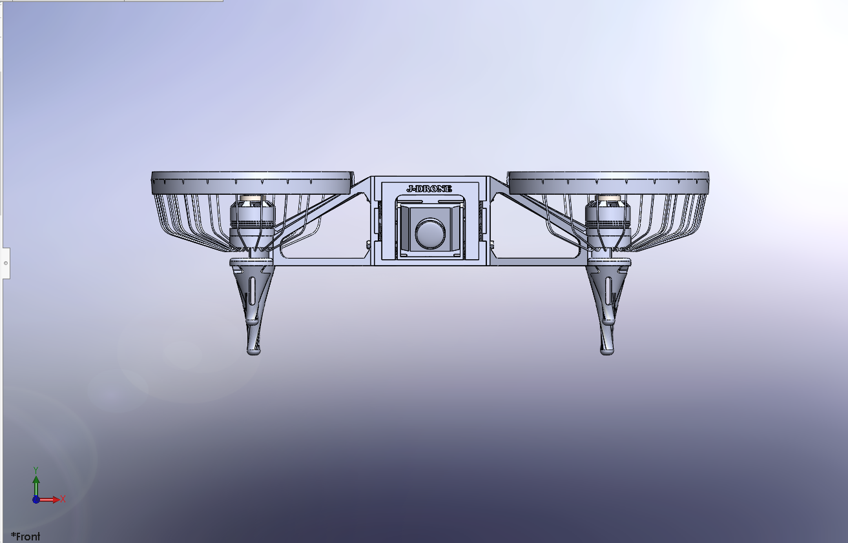
FRONT VIEW

Slide 27
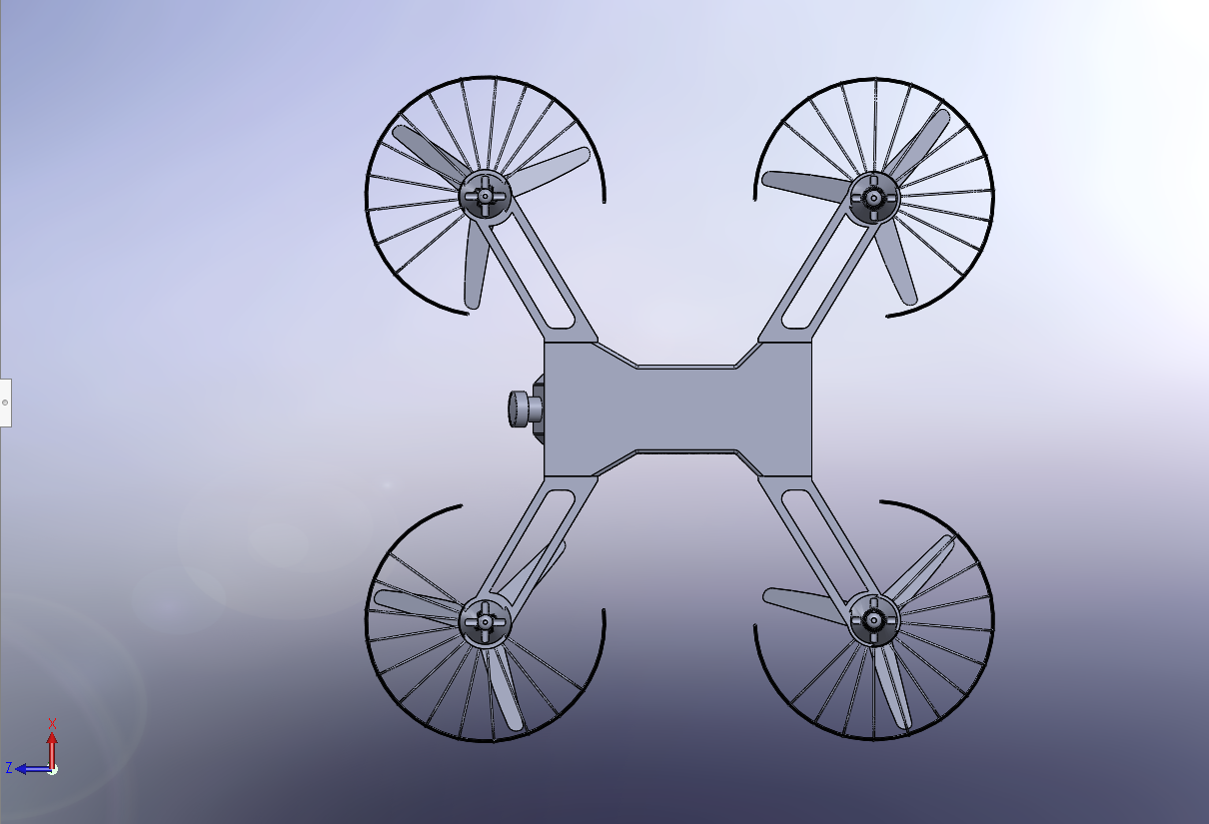
BOTTOM VIEW

Slide 28

BACK VIEW

Slide 29

ANGLE VIEW

Slide 30

WHEN THE MATERIAL OF THE FRAME IS GIVEN AS ABS, THE WEIGHT OF THE DRONE FRAME IS APPROXIMATELY 238 GRAMS

Slide 31
FIXED GEOMETRY IS ASSIGNED IN THE FRAME
FORCES WERE ASSIGNED ( 5N (A RANDOM VALUE GREATER THAN ITS OWN WEIGHT)) FROM BOTH THE TOP(IN THE TOP OF THE COVERING OF THE FRAME) AND THE BOTTOM (JUST BELOW THE MOTOR).
IN THE NEXT STEP MESHING WAS DONE.
AND FINALLY A SIMPLE STATIC STRUCTURAL ANALYSIS WAS FOUND.

Slide 32


Slide 33


Slide 34


Slide 35


Slide 36


Slide 37
THE FINAL ASSEMBLY OF THE DRONE IS PREPARED FOR THE PRESSURE FLOW SIMULATION WHICH IS IMPLEMENTED IN THE FOUR BRUSHLESS MOTORS.

Slide 38


Slide 39


Slide 40


Slide 41

FLOW SIMULATION VIDEO

Slide 42
SINCE THIS DRONE IS USED FOR A RACING COMPETITION (IAM3D COMPETITION) THAT CONSISTS OF IT TO FALL DOWN AND FACE ROUGH ENVIRONMENTS, THE PARTS ARE USUALLY REPLACED AFTER SOME TIME.
SO ANALYSIS AND SIMULATION OF THE DRONE HAD PROVEN THAT IT CAN BE USED FOR FURTHER PROTOTYPING AND FINALLY USING IT FOR RACING.

Slide 43
THE FRAME IS PREPARED FOR PROTOTYPING USING THE SLICING SOFTWARE CURA

Slide 44
FOR NOW THE PARTS THAT ARE TO BE PRINTED ARE GIVEN EQUAL VALUES FOR 3D PRINTING.
I.E,
i) INFILL DENSITY= 80 & INFILL PATTERN= GYROID
ii) SUPPORT PLACEMENT= EVERYWHERE &
SUPPORT OVERHANG ANGLE=60
iii) LAYER HEIGHT = 0.3, THEREFORE
NOZZLE DIAMETER=0.3

Slide 45


Slide 46


Slide 47


Slide 48
THANK YOU

